Slide 1
Maryland High School Assessments LAC Training
July 13, 2021

Slide 2
AGENDA
Time | Topics
1:00 – 1:05 PM | Introduction Staff Introductions
1:05 – 1:20 PM | Assessment Updates General Information Schedule and Timelines (Key Dates)
1:20 – 1:35 PM | Policy Test Security
1:35 – 2:05 PM | Computer Based Testing with the HSA Online System HSA Portal HSA Kiosk-based Testing HSA Browser-based Remote Testing HSA Online Practice Tests
2:05 – 2:15 PM | Short Break
2:15 – 2:45 PM | Remote Testing

Slide 3
AGENDA
Time | Topics
2:45 – 3:00 PM | Digital Manuals Paper Based Testing Accommodations Additional Materials UPS Pickup
3:00 – 3:15 PM | Support Materials Maryland Help & Support Site Modules Weekly LAC Communications Quick Start Guides Maryland Analysis and Reporting System (MARS) Overview How to Access Usernames and Passwords
3:15 – 3:30 PM | Questions and Answers

Slide 4
Staff Introductions
Cognia
Jaimie Rissin, Senior Program Manager
eMetric
Aarti Jagtap, Project Manager
Kaelee Harper, Support Center Manager
MSDE
Dr. Jennifer Judkins Assistant State Superintendent DAAIT
Brianna Creed, Assessment Operations Manager
Ann Herrmann, Assessment Development Manager
Karla Bressant, Finance Section Chief/LAC for LEA 24 Schools
Pauline Carey, Program Specialist
Paul Katula, Scoring Specialist
Tamara Lewis, State Test Security Officer
Jeremy Haack, Science Specialist
New LACs
Welcome!

Slide 5
Assessment Updates
Updates from MSDE
HS MISA
Key Dates Document
Posted on Maryland Help & Support Site
https://maryland.onlinehelp.cognia.org/wp-content/uploads/sites/15/2021/05/Maryland_HSA_Key_Dates_External_21-22_1.0.pdf
Notes:
(Jeremy H and Mary W will present guidance on who should be registered to test for the early Fall MISA 8, HS MISA, and January/May LS MISA tests.)
(Brianna will review the key dates doc)

Slide 6
MCAP HS MISA Timelines
Date | Task
July 13, 2021 July 14, 2021 July 15, 2021 | LAC Training LEA 24 Training Tech Coordinator Training
July 19, 2021 | Help & Support Site available with updated templates & user guides
July 26 – August 6, 2021 | Pre-ID Window (orders pre-printed student ID labels for PBT)
July 26 – October 22 | Bulk upload of classes and additional accessibility features/ accommodations in HSA Portal
August 3, 2021 | Unique accommodation requests due
August 30, 2021 August 31, 2021 September 1, 2021 | LAC Refresher Training LEA 24 Refresher Training Tech Coordinator Refresher Training
September 6 – October 22, 2021 | Window to Create and Schedule Test Sessions

Slide 7
MCAP HS MISA Timelines
Date | Task
September 3, 2021 | Manuals arrive in schools and LEAs Secure materials arrive in schools Track using Materials Management in HSA Portal
September 3 – October 13, 2021 | Additional Paper Materials Ordering Window
September 13 – October 22, 2021 | Early Fall HS MISA Online Testing Window
September 13 – October 15, 2021 | Early Fall HS MISA Paper Testing Window
September 20 – October 19, 2021 | Return All Paper Materials Schedule UPS Pick-up Request
October 20 – 22, 2021 | Late Pick-up Window for Paper Materials Schedule UPS Pick-up Request Return Online Testing Secure Ancillary Materials
After October 22, 2021 | Any scorable material must be returned at the cost of the county

Slide 8
MCAP HS MISA Timelines
Date | Task
October 22, 2021 | Last Day to finalize Student Online Test Invalidation
October 22, 2021 | Last Day for Tactile Graphics Pickup
November 8 – 12, 2021 | Participation File to LEAs & LEA 24 STCs for Correction
December 8, 2021 | Student level data posted to sFTP site
January 7, 2022 | Score reports and labels arrive in schools and LEAs

Slide 9
Test Security Reminders
COMAR 13A.03.04.04
Local School System Testing Designates
A. All personnel involved in testing must be employees of the local school system, be trained for their role, meet the requirements of their role as described herein, and sign a Department approved Test Administration and Certification of Training Form.
B. Personnel may not serve as a Test Administrator, Proctor, or Accommodator in the same testing room as a student who is a family member or who resides within the same dwelling.
Notes:
(Tamara)

Slide 10
Test Security Reminders
COMAR 13A.03.04.04
Local School System Testing Designates
Test Administrators (TAs)
(a) Selected by each public school’s principal subject to review and approval by the local Superintendent. (House Bill 617 / Senate Bill 562 passed in 2018)
(b) For any multi-state assessment consortium testing, TAs must possess a valid Maryland State Department of Education (MSDE) certificate for professional school staff.
Notes:
(Tamara)

Slide 11
Test Security Reminders
Eligible TAs (for any multi-state assessment consortium testing) include the following:
(i) State-certified teachers
(ii) Academic classroom, Special Education, Gifted and Talented, and EL teachers with conditional state certification or who are awaiting a response on certification from MSDE
(iii) State-certified guidance counselors, library media specialists, school psychologists, pupil personnel workers, and school administrators
(iv) Other state-certified teachers or retired state-certified teachers who may be working as instructional assistants, aides, or regular substitutes
Notes:
(Tamara)

Slide 12
Test Security Reminders
2021 - 2022 School Year Assessments
Consortium Assessments:
DLM grades 3-8 & 11 ELA & Mathematics
DLM grades 5, 8 & 11 Science
ACCESS for ELLs grades K-12
Alternate ACCESS for ELLs grades 1-12
Maryland-specific Assessments:
ELA grades 3-8 & 10
Mathematics grades 3-8, Alg I, Alg II & Geometry
High School Government & HS-MISA or LS MISA
MISA grades 5 & 8
Social Studies grade 8
KRA
Notes:
(Tamara)

Slide 13
Test Security Reminders
Common Errors
Lack of familiarity with the Test Administration Manual.
Not allowing the correct amount of time for a session.
Failure to properly assign students to accommodations/accessibility features.
Notes:
(Tamara)

Slide 14
Test Security Reminders
Special Concerns For Remote Testing
Replicate in-person test security guidelines to the greatest extent possible.
Communicate with students in advance to review important information such as scheduling, contact information & method, test submission, etc.
Testing environment should be quiet, well-lit, free from distractions and only include the test-taker.
Students should be seated comfortably with their testing device directly in front of them.
All prohibited devices such as cell phones, electronic games, etc. should be removed from the testing site. Wireless headsets are not permissible.
Notes:
(Tamara)

Slide 15
Test Security Reminders
Special Concerns For in-Person Testing
Facial coverings (any other PPE)students/staff may need
Materials on desks (sanitizer, tissues, gloves, wipes, air purifiers, etc.)
Any special seating arrangements/adjustments/requests
Monitoring (TAs & Proctors)
MSDE Monitoring
Tamara L. Lewis
tamara.lewis@maryland.gov
Notes:
(Tamara)

Slide 16
Maryland HSA Online Testing System
Online System
Portal
Users
Administration
Kiosk
Students
Classes
Test Sessions
Site
Setup
Browser
Remote Test
In-Person Test
Practice Test
Practice Test

Slide 17
Maryland HSA Online Testing System
Online System
Portal
Users
Administration
Kiosk
Students
Classes
Test Sessions
Site
Setup
Browser
Remote Test
In-Person Test
Practice Test
Practice Test

Slide 18
HSA Portal: Getting Started
Available via browser
hsaportal.cognia.org
Browser Specifications*: **updated
Chrome™ 91 or newer
Firefox® 89 or newer
Microsoft Edge™ 91 or newer
Safari® 14 or newer
*Please refer to the Technology Guidelines posted on the Help & Support website for latest updates.

Slide 19
HSA Portal: User Accounts
Already have a user account?
Continue to use it!
Prompted for password change?
Don’t have an account yet?
LACs and LEA 24 must create all other portal users within the HSA Portal.
Users will receive automated email with username and temporary password from MarylandProgramManagementTeam@cognia.org.
Add “Trusted” Email Sender,
No email? Check Spam folder,
LACs contact Technical Support,
STCs, Tech Coordinators, and Test Administrators contact LACs for accounts.

Slide 20
HSA Portal: Roles & Responsibilities
Role | Responsibilities
Local Accountability Coordinator (LAC) | Before & During Operational Testing: Manage portal users Upload student Pre-ID data Add additional students after Pre-ID window Request and approve student transfers in the Enrollment Transfer screen Edit student data and additional accessibility features/accommodations after Pre-ID window Create classes (proctoring groups) Schedule tests Track paper materials Approve TestMonitor Activations* During Operational Testing Manage and monitor student testing Review Dashboard Reactivate tests Invalidate tests After Testing Schedule UPS pick-up requests
*Optional

Slide 21
HSA Portal: Roles & Responsibilities
Role | Responsibilities
School Test Coordinator (STC) | Before & During Operational Testing: Manage portal users Upload student Pre-ID data Add additional students after Pre-ID window Edit student data and additional accessibility features/ accommodations after Pre-ID window Manage student transfers within your LEA Create classes (proctoring groups) Schedule tests Track paper materials Approve TestMonitor Activations* During Operational Testing: Manage and monitor student testing Review Dashboard Reactivate tests After Operational Testing: Generate Test Status Export Schedule UPS pick-up requests
NEW!
*Optional

Slide 22
HSA Portal: Roles & Responsibilities
Role | Responsibilities
Test Administrator (TA)* | Before & During Operational Testing: View Students View Classes (proctoring groups) View scheduled tests During Operational Testing: Monitor student testing from Test Sessions Details page Review Dashboard After Operational Testing: Validate Test Status Export with STC
*Test Administrator role is applicable to remote testing only

Slide 23
HSA Portal Demo
Recorded Modules are available on the Help & Support Site!
Add/Edit Student
Manually, or
Upload a Pre-ID file
Add/edit accommodations
Manually, or
Upload a file
Student Enrollment Transfers
Transferring Student within LEA
Transferring Student between LEAs
Create Classes (Proctoring groups)
Manually, or
Upload a file
Schedule Test Sessions
Notes:
Please say: “There are not changes to the Pre-Id layout as a result of remote testing. It is the same file layout as in previous years.”

Slide 24
Pre-ID Management
Pre-ID files can only be updated during the Pre-ID window.
Pre-ID window: July 26 – August 6, 2021.
Only LACs and STCs can upload files.
Same file for in-person testers and remote testers.
Successfully uploaded files will be processed the same day.
The LAC/STC that uploaded the file will receive an email notification once the file has processed.
Notes:
Please say: Please note that for the early fall, there is one elongated Pre-ID window rather than two separate short ones.
Please say: The layout has small changes. We increased the character count for the name and we added the gender section. However, you can have both students in the same file.

Slide 25
New Changes in the Pre-ID
Added a new option of “X” to the Gender field.
Increased the character count to 30 characters for student’s first name and last name fields.
Added a new value of “092021” for the Test Month Year field.
Added a new value of “Fall” for the Administration Code field.
Updated Answer Masking to be a Universal Tool.
Notes:
Please say: Please note that for the early fall, there is one elongated Pre-ID window rather than two separate short ones.
Please say: The layout has small changes. We increased the character count for the name and we added the gender section. However, you can have both students in the same file.

Slide 26
HSA Portal: Bulk File Uploads Review
File Upload | Data | Dates Available* | Record Limit
Portal Users | Add or edit portal user accounts for your organization | Now thru Oct 22, 2021 | 30
Pre-ID | Student data and accommodations | Jul 26 – Aug 6, 2021 | 40,000
Additional Accessibility Features/ Accommodations Data | Student accommodations only | Jul 26 – Oct 22, 2021 | 1,000
Class Data | Mapping students to classes or proctoring groups | Jul 26 – Oct 22, 2021 | 1,000
*Bulk file uploads are available during specific hours during operational testing window (3pm – 5:30am ET)
Notes:
Use the templates provided. Headings must match exactly.
CSV files, so do not include commas in the actual data.

Slide 27
HSA Portal: File Downloads Review
File Download | Data | Dates Available | Record Limit
Portal Users | List of portal user accounts for your organization | Now thru – Oct 22, 2021 | 30
Student Accommodations | Student accommodations only | Jul 26 – Oct 22, 2021 | -
Students Test Status | List of students with their test completion status by school/test | Sep 13 – Oct 22, 2021 | -
Pre-ID | Student enrollment data | Jul 26 – Oct 22, 2021 | -
All file downloads will be available throughout the operational administration and will not be blacked out during peak operational testing hours.

Slide 28
HSA Portal: Reactivating a Test
If a student turns in a test, but did not intend to, LACs and STCs can Reactivate a student’s test session.
A test can only be reactivated once it is in a Finished status.
The LACs and STCs should document and save the reason for reactivating the test.
The test status will be displayed as In Progress, but their previously listed End Time will remain the same until they have turned in the test again after having it reactivated.

Slide 29
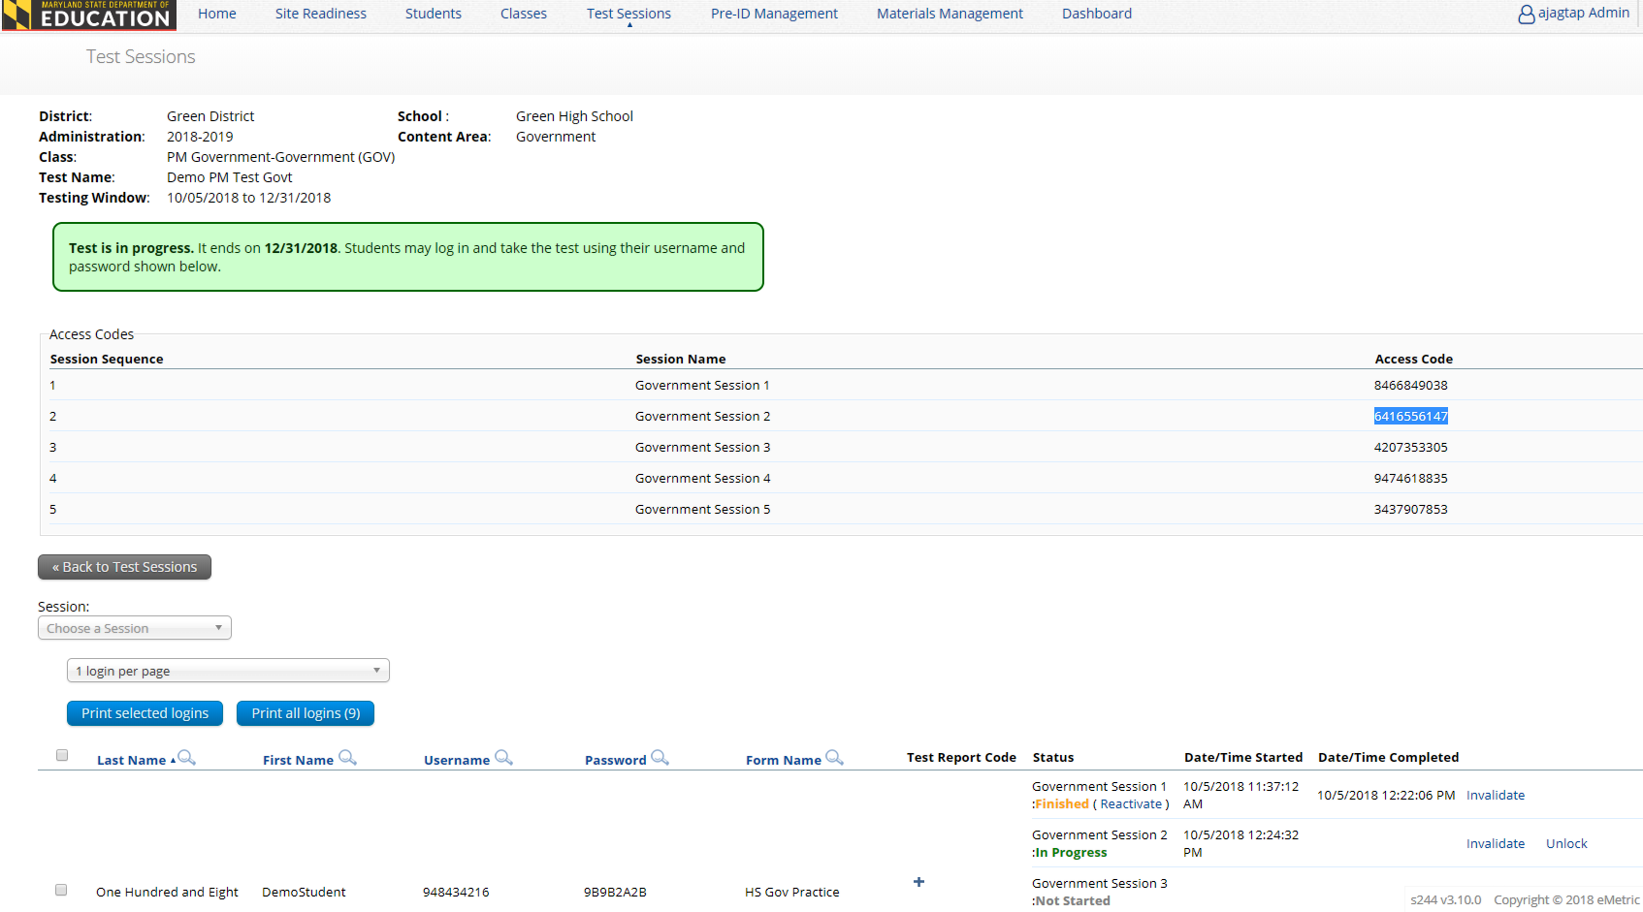
HSA Portal: Reactivating a Test

Slide 30
HSA Portal: Invalidating a Test
If a testing irregularity has occurred that lead to invalidating a test, LACs can invalidate the test via HSA Portal.
LEA24 STCs to see Karla Bressant and Juan Tituana.
Must invalidate a test for a student before scheduling to test again so they receive a different form.
The student must be put in a new class and scheduled to take the test.
This will generate a new password for the student’s test.

Slide 31
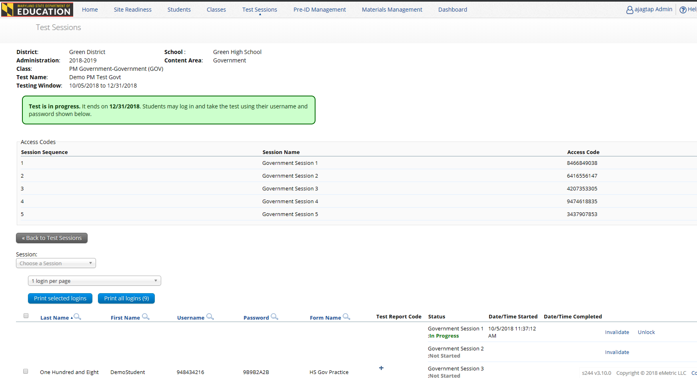
HSA Portal: Invalidating a Test

Slide 32
HSA Portal: Accommodations & Form Assignment
Accommodated form is automatically assigned to students with accommodations.
Must order accommodations and accessibility tools prior to scheduling students to take the test.
If missing of accommodations is caught before student logs in, assign accommodation, return to test session and click on Add or Update Students button.
If missing of accommodations is caught after student logs in, invalidate test, assign accommodation, add student to new class and reschedule test.

Slide 33
Maryland HSA Online Testing System
Online System
Portal
Users
Administration
Kiosk
Students
Classes
Test Sessions
Site
Setup
Browser
Remote Test
In-Person Test
Practice Test
Practice Test

Slide 34
HSA Kiosk: Overview
A secure test delivery platform, kiosk, is installed on each testing device (or the local network).
Windows, MacOS, and Linux Kiosk
Available to download in Portal
A new Windows kiosk for Early Fall 2021 HS MISA
iPad and Chromebook Applications
Download directly from App Stores
The Early Fall 2021 HS MISA in-person test must be taken on a kiosk or an app.

Slide 35
HSA Kiosk: Installation
Download HSA Kiosk
Install kiosk on testing devices*
Conduct Site Readiness Testing
Certify Site
*Installation Options:
Manual installation, scripted installation, software distribution via group policy
Review Kiosk Installation Guide available at maryland.onlinehelp.cognia.org

Slide 36
HSA Kiosk: Internet Connectivity
Beginning of Test:
Authenticate login
Download test content*
End of Test:
Submit responses for scoring
* Fetched from TestMonitor or eMetric Servers
Notes:
Internet connectivity is required!
Beginning and end of test
If you lose internet connectivity during test, keep testing
If internet connectivity is not restored when test is done, answers are saved in secure saved response folder on local machine.
When internet connectivity is restored simply relaunch the application and the answers will be sent and an other student can test on that machine.

Slide 37
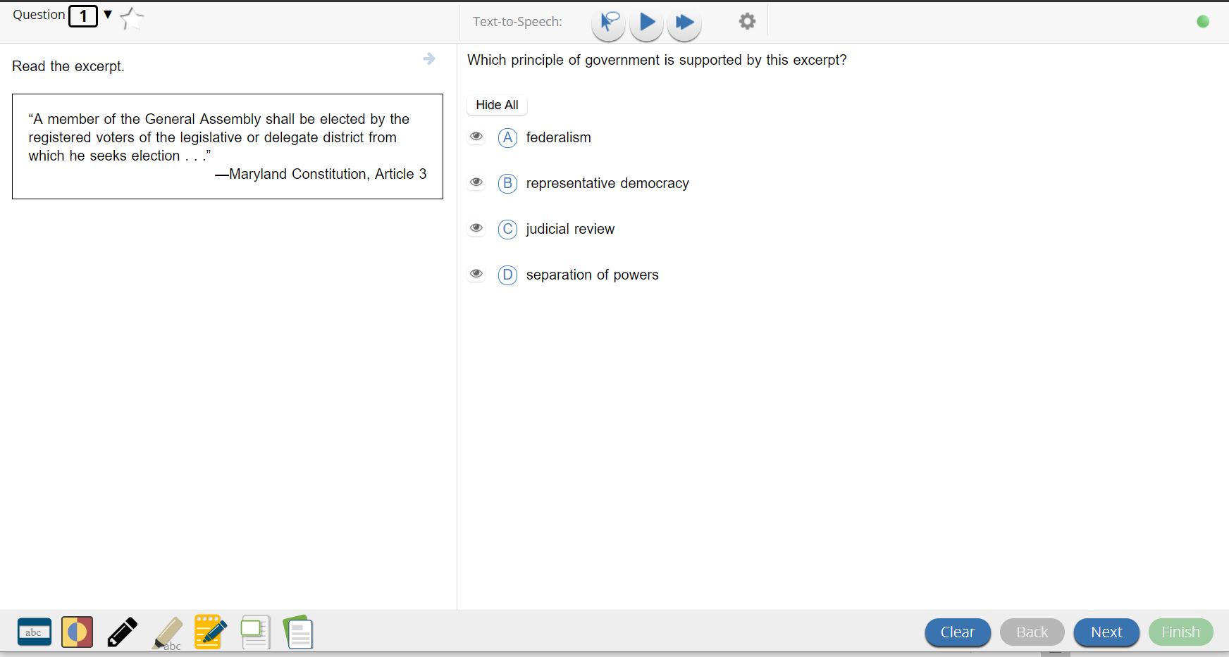
HSA Kiosk: Checking Internet Connectivity
Internet Connectivity is ON
Internet Connectivity is OFF

Slide 38
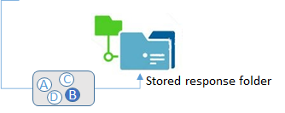
What happens if a student loses network connection in the middle of a test?

Slide 39
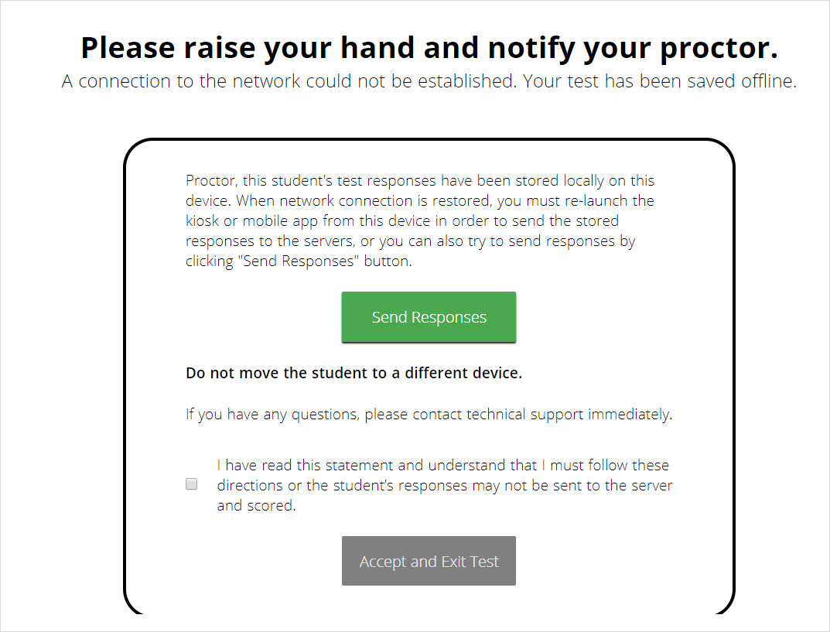
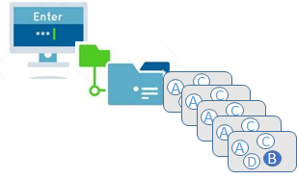
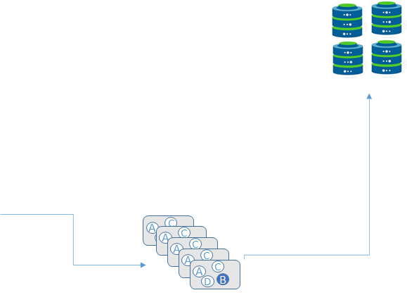
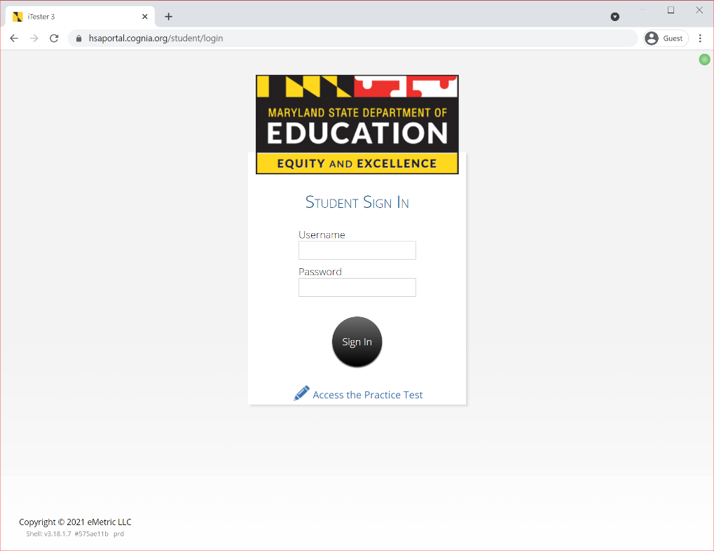
What if a student finishes a test but has no network connection?

Slide 40
HSA Kiosk Test Integrity
Loss of Network Connectivity Procedure Summary
If a student loses network connectivity in the middle of a test:
Keep testing on that device.
Test content and responses are stored securely on the test device.
Responses will be sent when network is restored.
If student finishes and is ready to turn in test prior to network being restored:
Allow student to turn in test.
Acknowledge the Offline Warning Message.
Record the exact device the student is testing on.
Ensure no network management tools or system maintenance will alter that devices files or configuration.
When network connectivity is restored, return to that exact device and relaunch the kiosk.
If you are unsure of the status of the student responses, call the help desk.

Slide 41
HSA Kiosk: Tech Support Notes
Do NOT move students to a new device when experiencing technical issues if the student has begun testing.
Only move once you are sure all responses synced to servers. Not sure? Call Technical Support.
(866) 207-8804
HSAhelpdesk@cognia.org

Slide 42
HSA Kiosk Demo
Logging In to the Kiosk
Entering a Session
Options page
Directions
Testing Interface
Review and Turn In

Slide 43
Passwords
Type of Password | Utilization | Entered By
Student Password | Used to log the student into the test | Student
Session Access Code | Used to log the student into the session of the test | Student

Slide 44
Important Reminder 1
All test and student information
will be cleared out from the HSA Portal
at the end of each test administration
to provide a “clean slate” for the
next testing administration.

Slide 45
Important Reminder 2
During operational testing window,
the hours between which LACs and STCs
can perform bulk upload of files are…
3:00 PM EST
to
5:30 AM EST

Slide 46
Important Reminder 3
During the operational testing window, LACs and STCs can still manually
add/edit students
create/edit classes
create/edit portal users

Slide 47
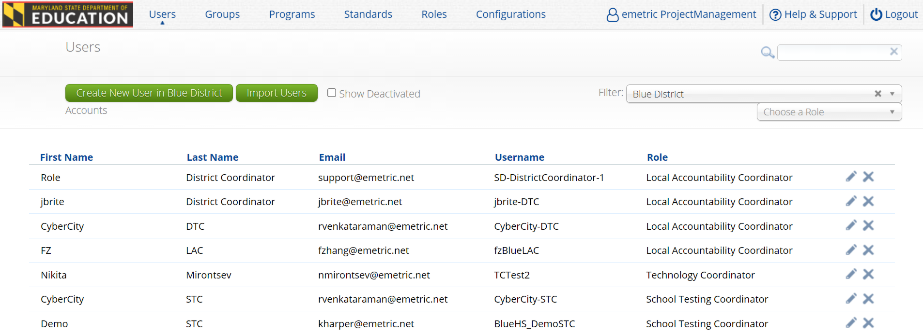
What’s new for Early Fall 2021 HS MISA Administration?
A new column is added to show user role on the Users listing page in the portal.

Slide 48
What’s new for Early Fall 2021 HS MISA Administration?
Proctor password will not be required for Early Fall 2021 in-person testing and remote testing.
A browser based remote testing will be offered for students taking the test remotely.
A new program ‘HSA Remote’ is created to support remote testing.
Use Test Status Export in lieu of Student Tracking Form for in-person testing and remote testing.

Slide 49
Short Break!

Slide 50
Maryland HSA Online Testing System
Online System
Portal
Users
Administration
Kiosk
Students
Classes
Test Sessions
Site
Setup
Browser
Remote Test
In-Person Test
Practice Test
Practice Test

Slide 51
HSA Browser Remote Testing: Overview
The Early Fall 2021 HS MISA remote test will be taken on a browser.
LSS can determine which students should participate in remote testing.
Offing the remote test administration is an option; LSS may elect to use this model at their own discretion.
TAs and proctors should only administer and monitor one session at a time

Slide 52
HSA Browser Remote Testing: Test Specifications
The remote test mirrors the in-person test.
Same number of items
One session
60 minutes
Browser Specifications*:
Chrome™ 91 or newer
Firefox® 89 or newer
Microsoft Edge™ 91 or newer
Safari® 14 or newer
Note: Students should not use browser in private or incognito mode.
*Please refer to the Technology Guidelines posted on the Help & Support website for latest updates.
Notes:
Note:
Students should not use browser in private or incognito mode

Slide 53
HSA Browser Remote Testing: Student Accommodations
The following embedded accessibility features will be available for some students when taking the remote test:
Color Contrast
Text-to-Speech (TTS)
Please note that TTS on browsers is partially supported. Students requiring TTS when remote testing, will be required to use Google Chrome browser or Microsoft Chromium-based Edge browser. Please note that accessibility features should be assigned to students via the accommodations file and be aligned with accessibility features embedded in a student’s daily instruction.
Students requiring any other accessibility features and/or accommodations will be required to take the test in-person using kiosk.

Slide 54
LAC & STC: Responsibilities
Develop plans to remote test during the Early Fall 2021 HS MISA administration test window.
Identify appropriate Test Administrators (TAs) to monitor remote tests.
MSDE recommends that LSS train a designated team of TAs for the remote test rather than training all TAs in all administration models.
Provide training to TAs.
Create accounts for TAs in the portal to administer remote tests.
Communicate remote testing intentions and requirements to students and parents.
Ensure that remote test takers have the remote test ancillary resources and are prepared to test prior to attending their assigned test session.

Slide 55
LAC & STC: Responsibilities (continued)
Create separate classes (proctoring groups) for remote test takers.
Create test sessions by scheduling classes (proctoring groups) for remote tests.
Create each student’s testing ticket and disseminate to students via a LSS determined secure system.
Ensure that a parallel meeting has been set up for each test session using the LSS approved distance learning software.
Ensure that all students scheduled for each test session also receive the invitation to the parallel meeting with their assigned TA.
After the remote testing session, export a Test Status report from the portal to mark students’ participation.

Slide 56
Test Administrator (TA): Responsibilities
Ensure that a parallel meeting with the class (proctoring group) has been scheduled for the test session.
Read test instructions over the audio of the distance learning software.
View Test Session Details to monitor students’ test status.
Assist students during remote testing over the audio call or chat functionality of the district approved distance learning software.
Post the start, end, remaining test time via the chat functionality of the district approved distance learning software.
Validate the Test Status export with the STC at the conclusion of testing.

Slide 57
Test Administrator (TA): Responsibilities (continued)
Review the following support resources:
HSA Remote Testing Browser User Guide,
HSA STC Quick Start Scheduling Remote Test Sessions,
HSA Student Quick Start Remote Testing, and
HSA Troubleshooting Tips for Remote Testing.
Ensure that remote test takers have received the remote test ancillary resources and are prepared to test prior to attending their assigned test session.

Slide 58
Student: Responsibilities
Ensure you meet the technology requirements to take a test remotely from home.
Ensure the room is free from distractions.
Take practice tests on a browser and device that will be used to take the Early Fall 2021 HS MISA remote test with integrity.
Ensure you have the correct test ticket login.
Keep the HSA Student QuickStart Remote Testing handy during testing.
Keep the HSA Remote Testing Troubleshooting Tips guide handy during testing.
Keep the HSA Remote Testing Browser User Guide handy during testing.

Slide 59
Remote Test Ancillary Resources
STC/ TA
Students/ Parents
HSA Remote Testing Browser User Guide
HSA STC Quick Start Scheduling Remote Test Sessions
HSA Student Quick Start Remote Testing
HSA Troubleshooting Tips for Remote Testing
Essential Elements of HS MISA Remote Testing (Video)
HSA Remote Testing Browser User Guide
HSA Student Quick Start Remote Testing
HSA Troubleshooting Tips for Remote Testing
Essential Elements of HS MISA Remote Testing (Video)

Slide 60
Test Administrator Workflow: Monitoring Test via HSA Portal

Slide 61
Test Administrator Workflow: Monitoring Test via HSA Portal
On the day of testing
On one browser tab:
Navigate to the HSA Portal: https://hsaportal.cognia.org/.
Navigate to the Test Sessions page
Select School, Subject, Program, and Test from the drop downs.
Find the remote testing test session that was scheduled by the LAC/STC for your class.
Click on View Details/Student Logins link.
Verify the test information, look for session access code, and verify your students.
Monitor students’ test status.
On second browser tab:
Open your district/school approved distance learning software (e.g., Zoom, Google Meet).
If you have an app, open the app on your device.
Set up an audio call with the class scheduled for the remote testing test session.
Ensure you have all your students joined the audio call.
Use the audio/ chat functionality:
For reading test instructions,
To give session access code,
To assist students during remote testing,
To post the start, end, remaining test time via the chat functionality
Notes:
Please say: Please use the chat feature to post the start time, remaining time, and end time for students.
Please say: When a student has submitted their test, please direct students to follow post testing procedures defined by your LSS.

Slide 62
Student Workflow: Accessing Test via a Web Browser

Slide 63
Student Workflow: Accessing Test via a Web Browser
On the day of testing
On one browser tab:
Navigate to the HSA Student Testing Interface web address: https://hsaportal.cognia.org/student/login.
When instructed, enter username and password.
Click Sign In button to log in.
Verify your information.
When instructed, click the session of the Remote Early Fall 2021 HS MISA assessment.
When instructed, enter the session access code provided by TA.
On the Directions screen you will read the directions with your TA and when instructed click Continue to begin.
On second browser tab:
Open your district/school approved distance learning software. (e.g., Zoom, Google Meet).
If you have an app, open the app on your device.
Join the audio call your TA has set up for the remote testing test session.
Use the audio/ chat functionality:
To hear the test instructions as the TA reads them out loud to the group,
To get the session access code, and
To ask questions.

Slide 64
Important Reminder 4
A student will need to be connected to the internet at:
Beginning of Test:
Authenticate login
Download test content*
End of Test:
Submit responses for scoring

Slide 65
Internet Connectivity Issues from Home
If internet connectivity goes in and out during testing, students will be able to continue to take the test.
Responses will be saved in browser’s cache.
If there is no internet connectivity when turning in the test, students will see a message providing instructions.
The message will instruct to relaunch the web browser on the testing device and navigate to the student test interface (https://hsaportal.cognia.org/student/login) after internet connectivity has been restored. This will force any test data saved on the browser to be sent for scoring.
NOTE: Students should not clear browsing data/cache when trying to establish internet connection during testing or submitting a test offline.

Slide 66
Support and Training Materials
Maryland Help & Support Site
https://maryland.onlinehelp.cognia.org/
Help Guide
HSA Remote Testing Browser User Guide
Quick Start Guides
HSA STC QuickStart Scheduling Remote Testing Sessions
HSA Student QuickStart Remote Testing
HSA Remote Testing Troubleshooting Tips
Video
Essential Elements of HS MISA Remote Testing
Help Desk
Students should contact their local school IT support with technical issues.
In the event the issue cannot be resolved, the STC and IT support should contact Cognia at 1-866-207-8804.
Notes:
Please “go live” to the Help and Support Site

Slide 67
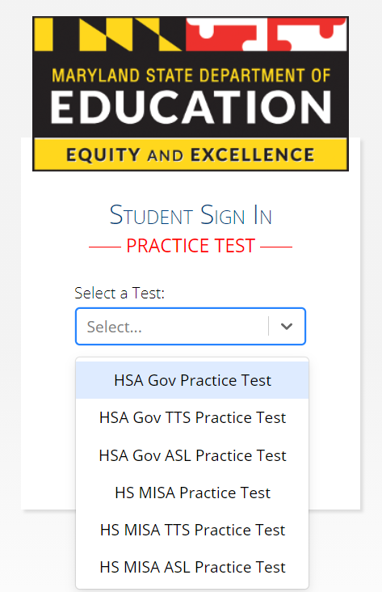
Online Practice Tests
https://hsapracticetest.cognia.org/student
The Practice Test can be taken on a browser or with the HSA Kiosk or mobile apps.
If a student needs magnification tool, they must use the Kiosk.
Students should take the practice tests on the devices to be used for testing.
Students will no longer need a username and password to access the practice tests.

Slide 68
Any Questions?

Slide 69
Manuals
Printed manuals will be available
Digital manuals are still available if needed.
Manuals are located on the Help and Support Site
https://maryland.onlinehelp.cognia.org
Guides > MSDE Manuals
Test Coordinator Manual (TCM)
Test Administrator Manual (TAM)
Remote Test Administrator Manual
Online manuals include clickable links including within Table of Contents for quick searches

Slide 70
Paper Based Testing
Paper Accommodations
Receiving Paper Materials
Ordering Additional Materials
Returning Materials
Scheduling UPS Pick-up Request

Slide 71
Paper Accommodation
Paper testing window (September 13 – October 15, 2021)
Need a documented IEP, 504, EL plan or approval from MSDE for paper materials
Paper materials are automatically ordered with the submission of the Pre-ID file (window: July 26 – August 6, 2021)
Additional Materials can be ordered September 3 – October 13, 2021

Slide 72
Receiving Materials
Ensure that you received all your materials
Discrepancy? Call the HSA Help Desk at (866) 207-8804
Tracking your orders on the HSA Portal

Slide 73
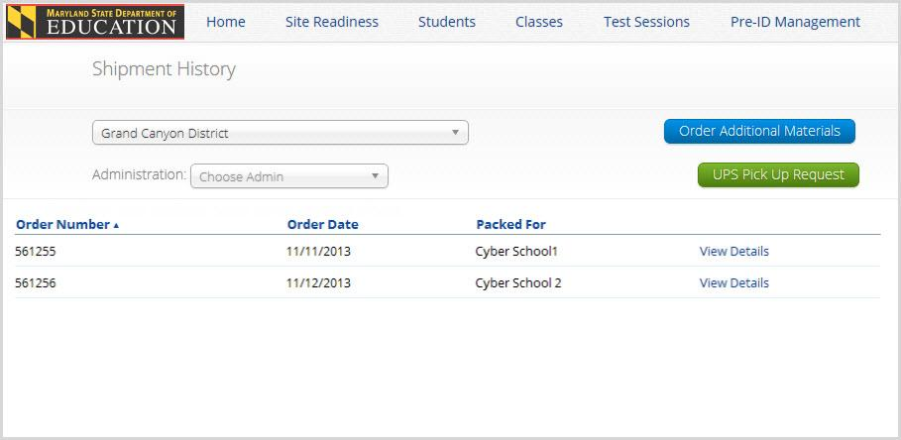
Materials Management

Slide 74
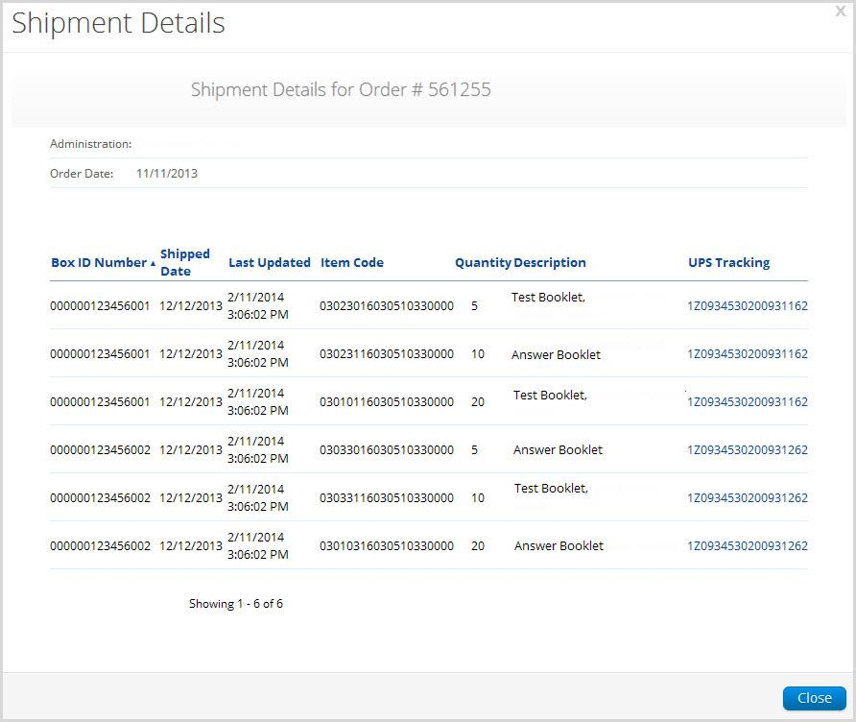
Materials Management

Slide 75
Materials Management
Additional Materials
To order materials you will need the school’s MP Ship Code. This code may be found on the Material Summary Form. (see example on next slide)
Additional test materials, may be ordered through Materials Management from September 3 – October 13, 2021
Manuals can be found on the Maryland Help & Support Site (https://maryland.onlinehelp.cognia.org) or ordered through Additional Materials

Slide 76
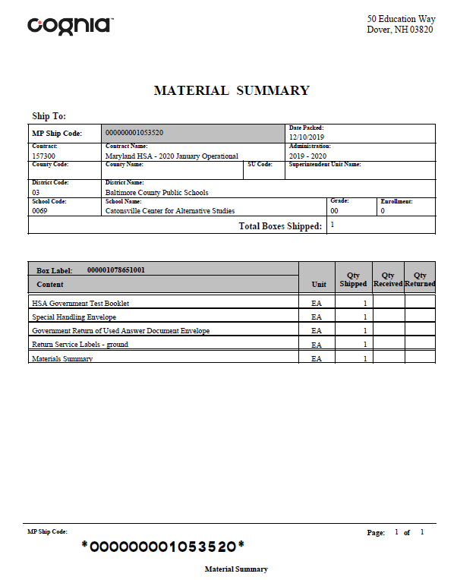
Materials Management
Additional Materials
Both MP Ship codes (Manuals or Test Material Shipment) will work.
MP Ship Code

Slide 77
Materials Management
Additional Materials

Slide 78
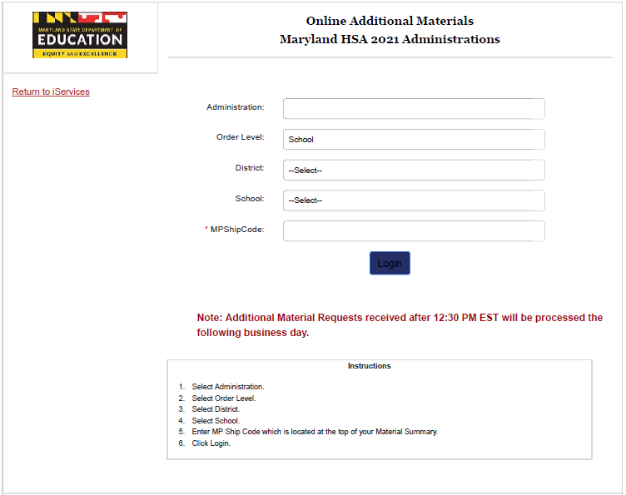
Materials Management
Additional Materials

Slide 79
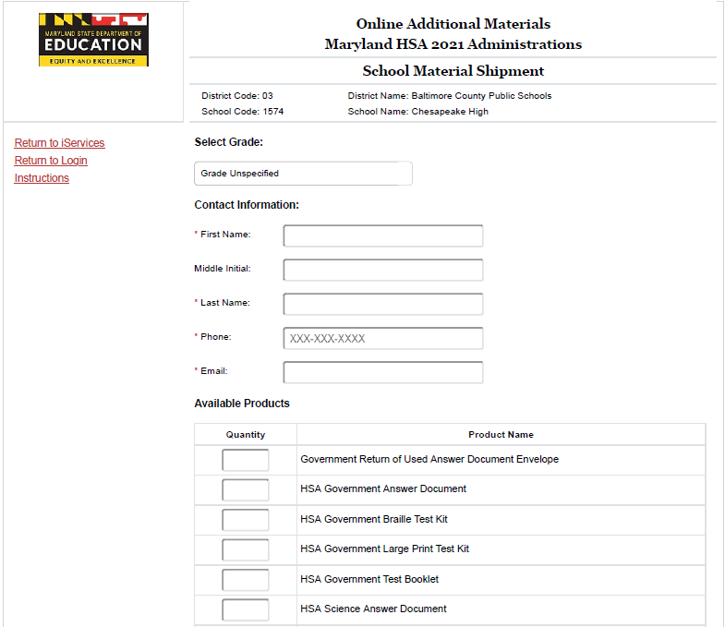
Materials Management
Additional Materials

Slide 80
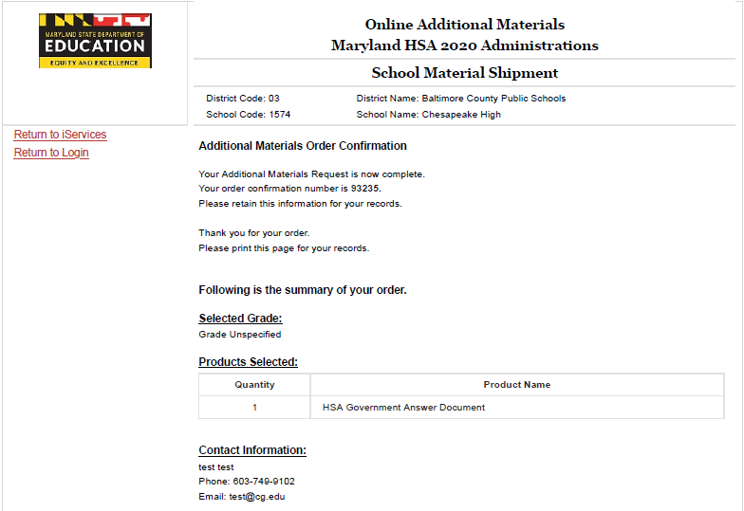
Materials Management
Additional Materials
Once the order is approved by MSDE and shipped, this number will appear on the Materials Management page.

Slide 81
Returning Materials
Special Handling Envelope
Used Accommodated Materials
Invalidated Answer Sheets
LEA 55 Answer Sheets
Return of Used Answer Sheets Envelope

Slide 82
Returning Materials
Use the boxes that were sent to you
UPS return labels included in your shipment
White Tyvek envelopes (Used Answer Sheets Envelope, Special Handling Envelope)
Unused Answer Sheets (different each administration)
Used and Unused Test Books
Other test materials

Slide 83
Materials Management
Scheduling a UPS Pickup (September 20 – October 19, 2021)

Slide 84
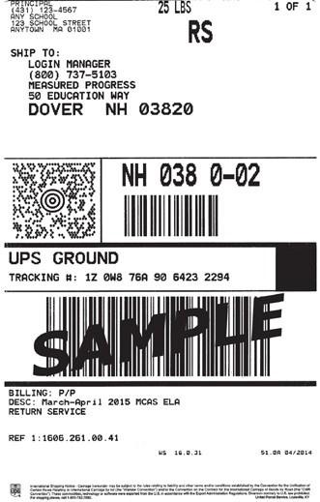
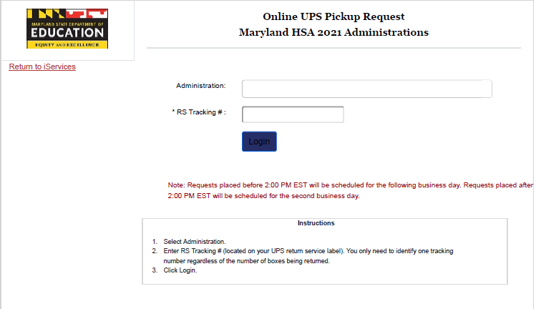
Materials Management
Scheduling a UPS Pickup (September 20 – Oct 19, 2021)

Slide 85
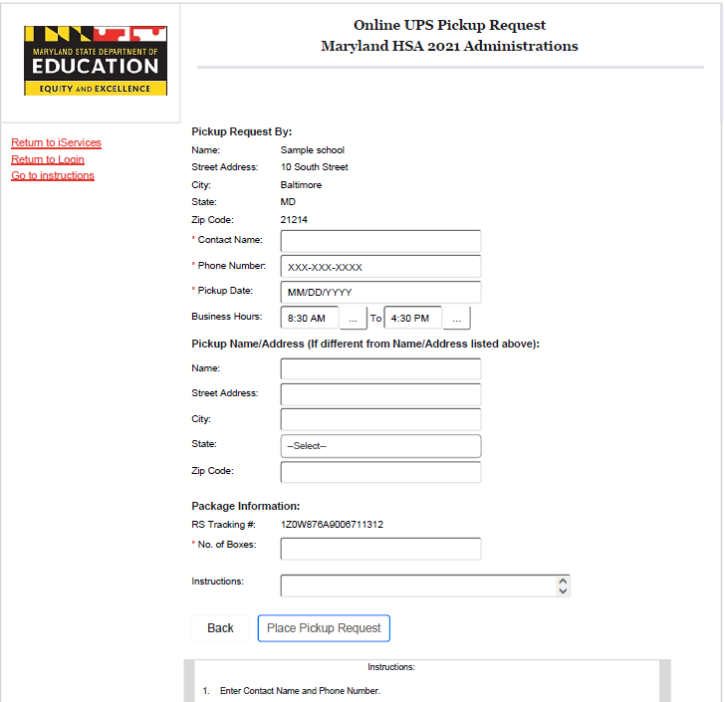
Materials Management
Scheduling a UPS Pickup (September 20 – October 19, 2021)
Your tracking number will automatically pull in your shipping information.
Fill out any other necessary information
Click on the Place Pickup Request button to schedule

Slide 86
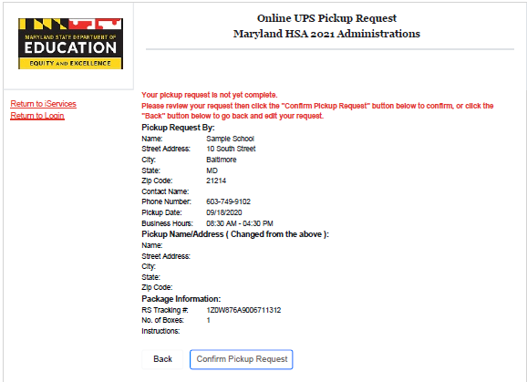
Materials Management
Scheduling a UPS Pickup (September 20 – October 19, 2021)
Make sure to review the pickup request one more time on the Confirmation Screen.
You will need to click the button Confirm Pickup Request to complete the schedule request

Slide 87
Support Materials
Maryland Help & Support Site
How to Modules, Essentials of Remote Testing Video
Weekly LAC/LEA 24 STC Communications
Quick Start Guides
Help Desk

Slide 88
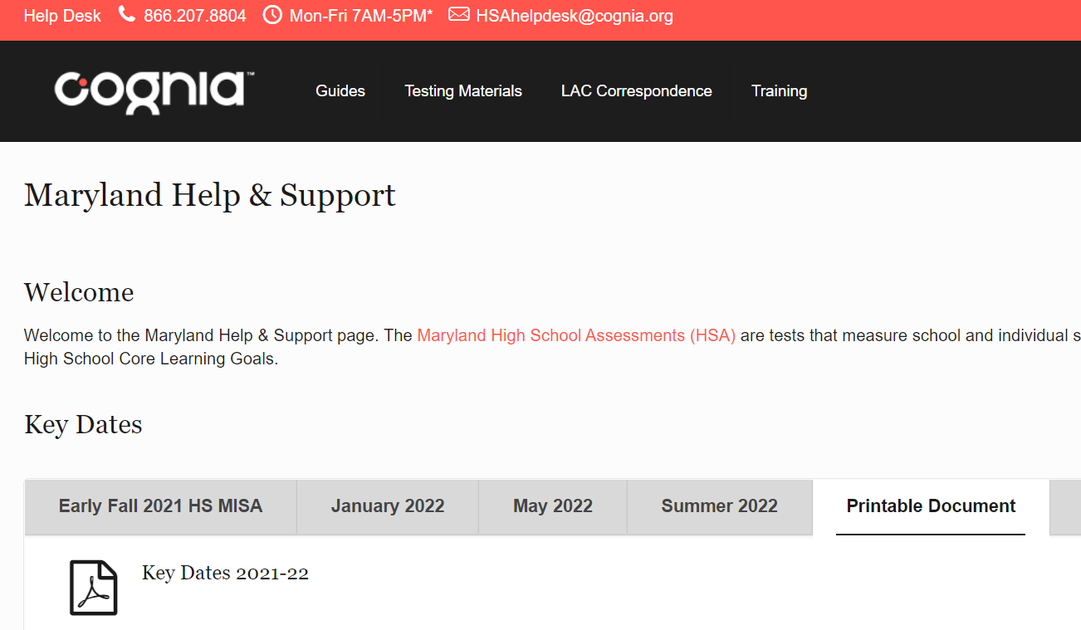
Maryland Help & Support Site
https://maryland.onlinehelp.cognia.org/

Slide 89
Maryland Analysis and Reporting System (MARS)

Slide 90
Maryland Analysis and Reporting System (MARS)
Overview of MARS
How to Access
Usernames & Passwords
User Roles

Slide 91
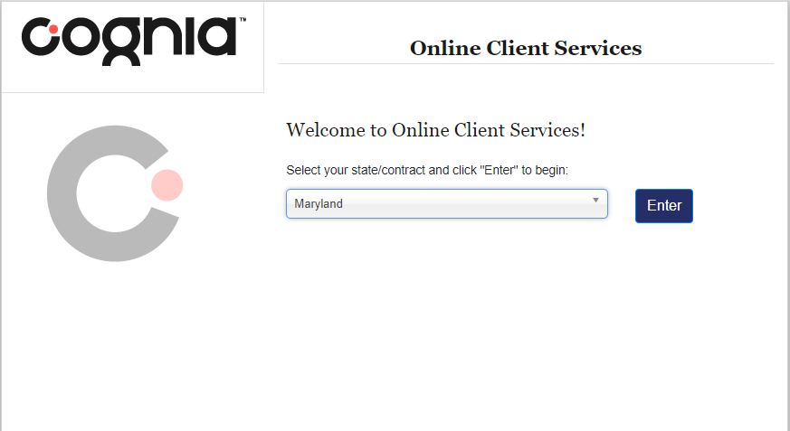
Maryland Analysis and Reporting System (MARS)
Accessing MARS
Link within Help and Support Site
http://iservices.cognia.org/
Select Maryland and click Enter

Slide 92
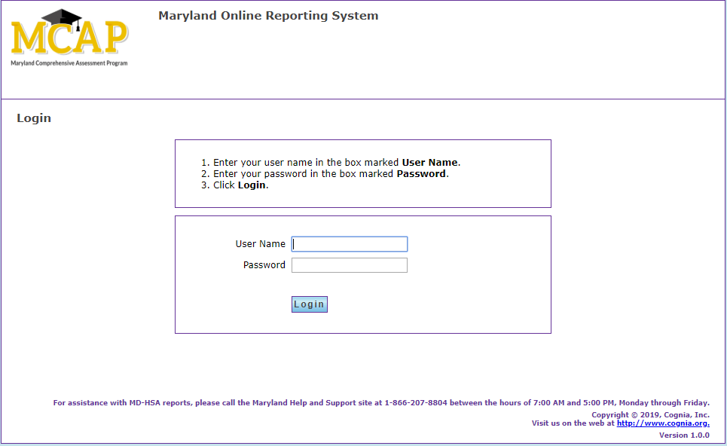
Maryland Analysis and Reporting System (MARS)
Usernames and Passwords have not changed
Contact helpdesk for assistance
Roles / Permissions:
State User / All Districts & Schools
LAC User / All Schools within Own LSS
School User / Own School

Slide 93
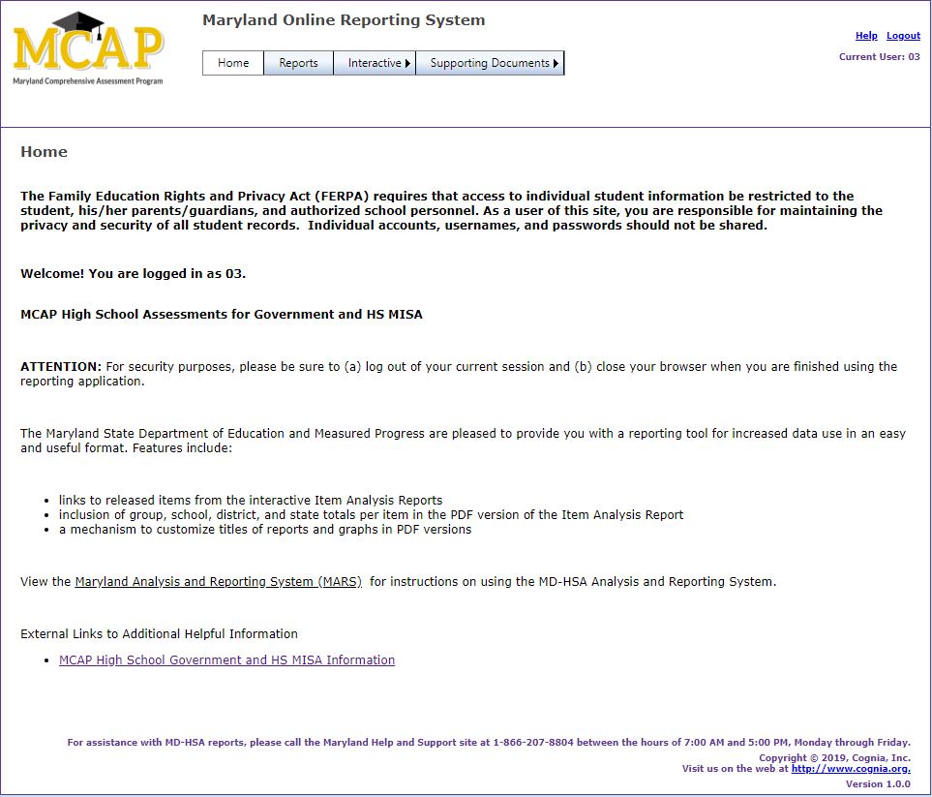
Maryland Analysis and Reporting System (MARS)
Reports (Static Report PDFs)
Individual Student Reports
Performance Level Summary Report
District Summary of Schools
School Roster Report
Score Labels

Slide 94
Maryland Analysis and Reporting System (MARS)
Interactive
Interactive reports can be customized and include:
Item Analysis Report
Performance Level Summary Chart

Slide 95
Have Additional Questions?
Cognia Technical Product Support (866) 207-8804 or HSAhelpdesk@cognia.org
Help & Support Site maryland.onlinehelp.cognia.org

Slide 96
Thank you.
Cognia is a global nonprofit that has the knowledge to help schools improve outcomes for all learners.

