Slide 1




Maryland High School Assessments
LAC Training
October 20, 2020

Slide 2
AGENDA
Time | Topics
9:00 – 9:15 AM | Introduction Staff Introductions
9:15 – 9:55 AM | Computer Based Testing New LACs Refresher
9:55 – 10:00 AM | Short Break

Slide 3
AGENDA
Time | Topics
10:00 – 10:30 AM | Policy Test Security Assessment Updates General Information Schedule and Timelines (Key Dates)
10:30 – 10:45 AM | Computer Based Testing with the HSA Online System HSA Portal HSA Kiosk Digital Manuals Paper Based Testing Accommodations Additional Materials UPS Pickups

Slide 4
AGENDA
Time | Topics
10:45 – 11:00 AM | Support Materials Maryland Help & Support Site Modules Weekly LAC Communications Quick Start Guides Maryland Analysis and Reporting System (MARS) Overview How to Access Usernames and Passwords
11:00 – 11:30 AM | Questions and Answers

Slide 5
Introduction
Staff Introductions

Slide 6
Staff Introductions
Cognia
  John Miller, Lead Program Manager
eMetric
  Aarti Jagtap, Project Manager
  Kaelee Harper, Support Center Manager
MSDE
  Dr. Jennifer Judkins Assistant State Superintendent DAAIT
  Brianna Creed, Assessment Operations Manager
  Ann Herrmann, Assessment Development Manager
  Karla Bressant, Finance Section Chief/LAC for LEA 24 Schools
  Pauline Carey, Program Specialist
  Paul Katula, Scoring Specialist
  Tamara Lewis, State Test Security Officer
  Jeremy Haack, Science Specialist
  Beth Ann Haas, Government Specialist
  Leah Renzi, Coordinator of Social Studies

Slide 7
HSA Online System
Computer Based Testing

Slide 8
Agenda
HSA Portal
  Overview
  Demonstration
  File Uploads & Downloads
  Reactivations & Invalidations
HSA Kiosk
  Overview
  Demonstration
  Proctor Password
  Online Certification Test

Slide 9
Maryland HSA Online Testing System
Online System
Portal
Users
Administration
Kiosk
Windows, MacOS and Linux
Kiosk
iOS and Chrome
Tablet App
Students
Classes
Test Sessions
Site
Setup
Practice Test
Browser

Slide 10
Maryland HSA Online Testing System
Online System
Portal
Users
Administration
Kiosk
Windows, MacOS and Linux
Kiosk
iOS and Chrome
Tablet App
Students
Classes
Test Sessions
Site
Setup
Practice Test
Browser

Slide 11
HSA Portal: Getting Started
Available via browser
  hsaportal.cognia.org
Browser Specifications*:
  Chrome™ 86 or newer
  Firefox® 80 or newer
  Microsoft Edge™ 85 or newer
  Safari® 14 or newer
  *Please refer to the Technology Guidelines posted on the Help & Support website for latest updates.

Slide 12
HSA Portal: User Accounts
Already have a user account?
  Continue to use it!
  Prompted for password change?
Don’t have an account yet?
  LACs and LEA 24 must create all other portal users within the HSA Portal
  Users will receive automated email with username and temporary password from MarylandProgramManagementTeam@cognia.org
    Add “Trusted” Email Sender
    No email? Check Spam folder
    LACs contact Technical Support
    STCs and Tech Coordinators contact LACs for accounts

Slide 13
HSA Portal: Roles & Responsibilities
Role | Responsibilities
Local Accountability Coordinator (LAC) | Before & During Operational Testing: Manage portal users Upload student Pre-ID data Add additional students after Pre-ID window Request and approve student transfers in the Enrollment Transfer screen Edit student data and additional accessibility features/accommodations after Pre-ID window Create classes (proctoring groups) Schedule tests Track paper materials Approve TestMonitor Activations* During Operational Testing Manage and monitor student testing Review Dashboard Reactivate tests Invalidate tests After Testing Schedule UPS pick-up requests
*Optional

Slide 14
HSA Portal: Roles & Responsibilities
Role | Responsibilities
School Test Coordinator (STC) | Before & During Operational Testing: Manage portal users Upload student Pre-ID data Add additional students after Pre-ID window Edit student data and additional accessibility features/ accommodations after Pre-ID window Manage student transfers within your LEA Create classes (proctoring groups) Schedule tests Track paper materials Approve TestMonitor Activations* During Operational Testing: Manage and monitor student testing Review Dashboard Reactivate tests After Operational Testing: Schedule UPS pick-up requests
*Optional

Slide 15

HSA Portal Demo
Recorded Modules are available on the Help & Support Site!
Add/Edit Student
  Manually, or
  Upload a Pre-ID file
  Add/edit accommodations
    Manually, or
    Upload a file
Student Enrollment Transfers
  Transferring Student within LEA
  Transferring Student between LEAs
Create Classes (Proctoring groups)
  Manually, or
  Upload a file
Schedule Test Sessions

Slide 16
Pre-ID Management
Pre-ID files can only be updated during the Pre-ID window.
Upcoming Pre-ID window for January administration
  October 28 – November 11, 2020
  December 10 – 17, 2020
Only LACs and STCs can upload files.
Successfully uploaded files will be processed the same day.
The LAC/STC that uploaded the file will receive an email notification once the file has processed.

Slide 17
HSA Portal: Bulk File Uploads Review
File Upload | Data | Dates Available* | Record Limit
Portal Users | Add or edit portal user accounts for your organization | Oct 12, 2020 – Aug 2, 2021 | 30
Pre-ID | Student data and accommodations | Oct 28 – Nov 11, 2020 | 40,000
Additional Accessibility Features/ Accommodations Data | Student accommodations only | Nov 12, 2020 – Jan 4, 2021 | 1,000
Class Data | Mapping students to classes or proctoring groups | Nov 12, 2020 – Jan 4, 2021 | 1,000
*Limited availability during operational testing window
Notes:
Use the templates provided. Headings must match exactly.
CSV files, so do not include commas in the actual data.

Slide 18
HSA Portal: File Downloads Review
File Download | Data | Dates Available | Record Limit
Portal Users | List of portal user accounts for your organization | Oct 12, 2020 – Aug 2, 2021 | 30
Student Accommodations | Student accommodations only | Oct 28, 2020 – Feb 5, 2021 | -
Students Test Status | List of students with their test completion status by school/test | Jan 11 – Feb 5, 2021 | -
Pre-ID | Student enrollment data | Oct 28, 2020 – Feb 5, 2021
All file downloads will be available throughout the operational administration and will not be blacked out during peak operational testing hours.

Slide 19
HSA Portal: Reactivating a Test
If a student turns in a test, but did not intend to, LACs and STCs can Reactivate a student’s test session.
A test can only be reactivated once it is in a Finished status.
A proctor password is required for student to access reactivated test session.
The LACs and STCs should document and save the reason for reactivating the test.
If student needs access to previously answered questions, the LAC and STC must also Unlock the test.
The test status will be displayed as In Progress, but their previously listed End Time will remain the same until they have turned in the test again after having it reactivated.

Slide 20
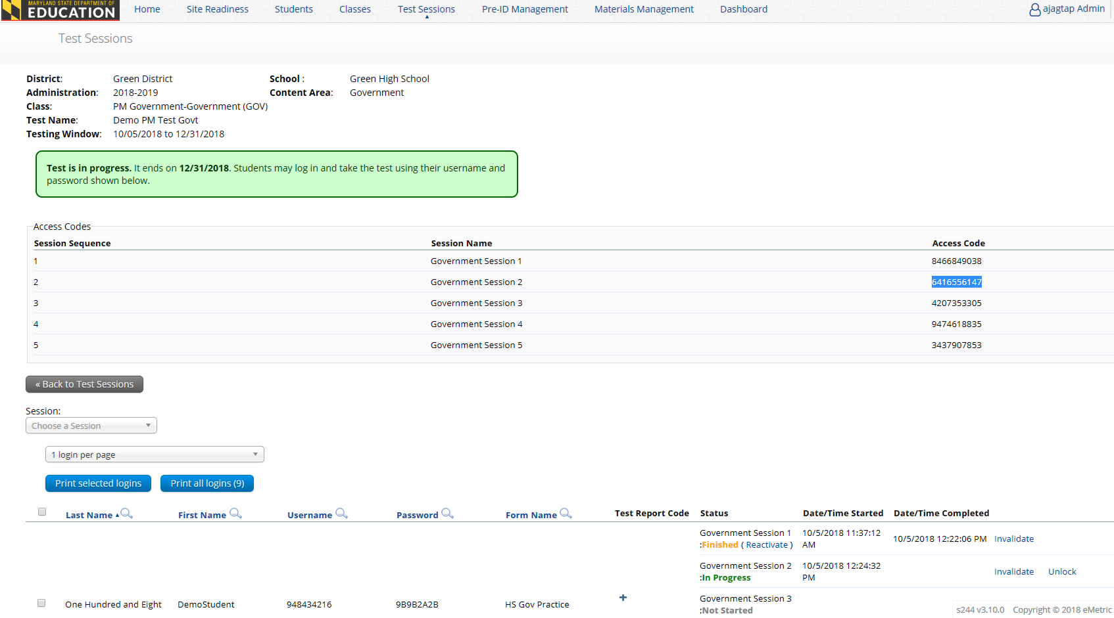
HSA Portal: Reactivating a Test

Slide 21
HSA Portal: Invalidating a Test
If a testing irregularity has occurred that lead to invalidating a test, LACs can invalidate the test via HSA Portal.
  LEA24 STCs to see Karla Bressant.
Must invalidate a test for a student before scheduling to test again so they receive a different form.
  The student must be put in a new class and scheduled to take the test.
  This will generate a new password for the student’s test.

Slide 22
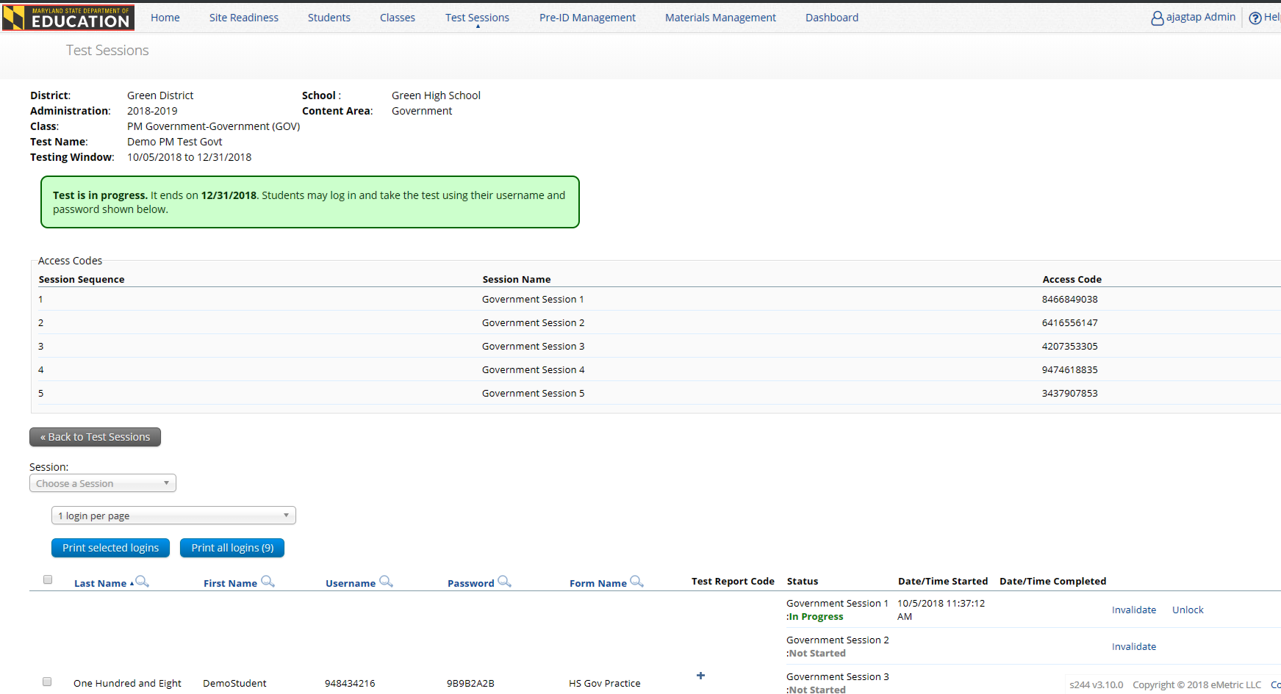
HSA Portal: Invalidating a Test

Slide 23
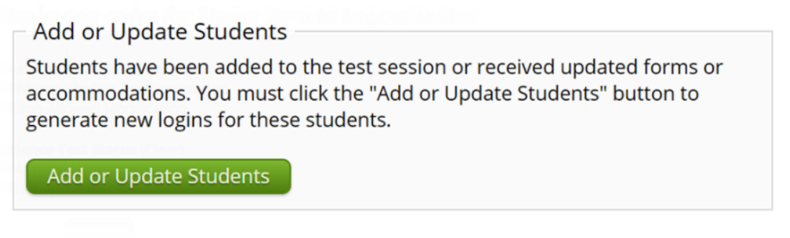
HSA Portal: Accommodations & Form Assignment
Accommodated form is automatically assigned to students with accommodations.
Must order accommodations and accessibility tools prior to scheduling students to take the test.
  If missing of accommodations is caught before student logs in, assign accommodation, return to test session and click on Add or Update Students button.
  If missing of accommodations is caught after student logs in, invalidate test, assign accommodation, add student to new class and reschedule test.

Slide 24
Maryland HSA Online Testing System
Online System
Portal
Users
Administration
Kiosk
Windows, MacOS and Linux
Kiosk
iOS and Chrome
Tablet App
Students
Classes
Test Sessions
Site
Setup
Practice Test
Browser

Slide 25
HSA Kiosk: Overview
Secure testing kiosk installed on each testing device (or the local network)
Practice test available on non-secure browser
  Browser Specifications*:
  Chrome™ 86 or newer
  Firefox® 80 or newer
  Microsoft Edge™ 85 or newer
  Safari® 14 or newer
    *Please refer to the Technology Guidelines posted on the Help & Support website for latest updates.

Slide 26

HSA Kiosk: Installation
Download HSA Kiosk
Install kiosk on testing devices*
Conduct Site Readiness Testing
Certify Site
*Installation Options:
Manual installation, scripted installation, software distribution via group policy
Review Kiosk Installation Guide available at maryland.onlinehelp.cognia.org

Slide 27



HSA Kiosk: Internet Connectivity
Beginning of Test:
Authenticate login
Download test content*
End of Test:
Submit responses for scoring
* Fetched from TestMonitor or eMetric Servers
Notes:
Internet connectivity is required!
Beginning and end of test
If you lose internet connectivity during test, keep testing
If internet connectivity is not restored when test is done, answers are saved in secure saved response folder on local machine.
When internet connectivity is restored simply relaunch the application and the answers will be sent and an other student can test on that machine.

Slide 28
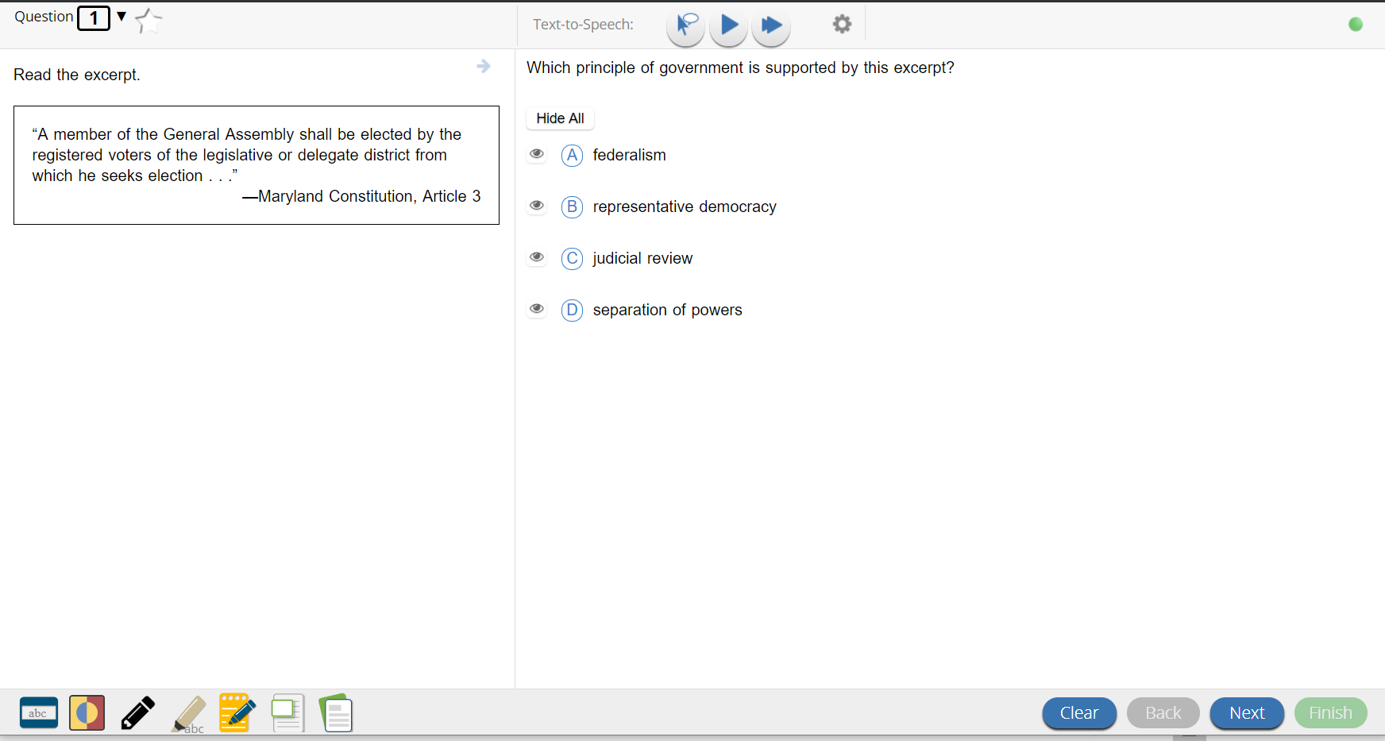

HSA Kiosk: Checking Internet Connectivity
Internet Connectivity is ON
Internet Connectivity is OFF

Slide 29
HSA Kiosk: Offline Warning Message
When a student turns in his/her test offline and there are responses that are stored locally, an offline warning message will be shown to the student. The message will alert the student to notify his/her proctor that there are locally stored responses, and the proctor will be prompted to click a button to try and send the student responses before closing the kiosk.

Slide 30





HSA Kiosk: Failsafe Mechanism
Saved Response Location
Notes:
Make sure you explain that the files will disappear form the saved response location when sent to the server. Otherwise, saved forever.

Slide 31
HSA Kiosk: Tech Support Notes
Do NOT move students to a new device when experiencing technical issues if the student has begun testing.
  Only move once you are sure all responses synced to servers. Not sure? Call Technical Support.
    (866) 207-8804
    HSAhelpdesk@cognia.org

Slide 32
HSA Kiosk Demo
Logging In to the Kiosk
Entering a Session
Options page
Directions
Testing Interface
Review and Turn In

Slide 33

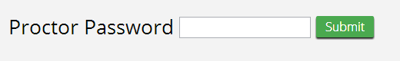
HSA Kiosk: Proctor Password
Students who are inactive longer than 60 minutes or had their device powered down will require a proctor password to resume testing that session.
Proctor password found on the Administration home page for LACs and STCs.

Slide 34
Passwords
Type of Password | Utilization | Entered By
Student Password | Used to log the student into the appropriate test | Student
Session Access Code | Used to log the student into the appropriate session of the test | Student
Proctor Password** | Used to log the student into the appropriate session of the test if the student powered down the device, and needs to resume the session, or if student is inactive for more than an hour. | Proctor
** Proctor password must be kept confidential.

Slide 35
Online Certification Test
Mock operational test to help you prepare.
  Must complete all tasks (create classes, schedule tests, print student test tickets)
November 16 – December 4, 2020
Forms and test length will be identical to operational tests.
Completely separate from the Site Readiness Test and Certification.

Slide 36
Any Questions?

Slide 37
Maryland High School Assessments
LAC Training
October 20, 2020

Slide 38
Welcome and Staff Introductions
Cognia
  John Miller, Lead Program Manager
eMetric
  Aarti Jagtap, Project Manager
  Kaelee Harper, Support Center Manager
MSDE
  Dr. Jennifer Judkins Assistant State Superintendent DAAIT
  Brianna Creed, Assessment Operations Manager
  Ann Herrmann, Assessment Development Manager
  Karla Bressant, Finance Section Chief/LAC for LEA 24 Schools
  Pauline Carey, Program Specialist
  Paul Katula, Scoring Specialist
  Tamara Lewis, State Test Security Officer
  Jeremy Haack, Science Specialist
  Beth Ann Haas, Government Specialist
  Leah Renzi, Coordinator of Social Studies

Slide 39
AGENDA
Time | Topics
10:00 – 10:30 AM | Policy Test Security Assessment Updates General Information Schedule and Timelines (Key Dates)
10:30 – 10:45 AM | Computer Based Testing with the HSA Online System HSA Portal HSA Kiosk Digital Manuals Paper Based Testing Accommodations Additional Materials UPS Pickups

Slide 40
AGENDA
Time | Topics
10:45 – 11:00 AM | Support Materials Maryland Help & Support Site Modules Weekly LAC Communications Quick Start Guides Maryland Analysis and Reporting System (MARS) Overview How to Access Usernames and Passwords
11:00 – 11:30 AM | Questions and Answers

Slide 41
Test Security Reminders
COMAR 13A.03.04.04
Local School System Testing Designates
A. All personnel involved in testing must be employees of the local school system, be trained for their role, meet the requirements of their role as described herein, and sign a Department approved Test Administration and Certification of Training Form.
B. Personnel may not serve as a Test Administrator, Proctor, or Accommodator in the same testing room as a student who is a family member or who resides within the same dwelling.

Slide 42
Test Security Reminders
COMAR 13A.03.04.04
Local School System Testing Designates
Test Administrators (TAs)
(a) Selected by each public school’s principal subject to review and approval by the local Superintendent. (House Bill 617 / Senate Bill 562 passed in 2018)
(b) For any multi-state assessment consortium testing, TAs must possess a valid Maryland State Department of Education (MSDE) certificate for professional school staff.

Slide 43
Test Security Reminders
Eligible TAs (for any multi-state assessment consortium testing) include the following:
(i) State-certified teachers
(ii) Academic classroom, Special Education, Gifted and Talented, and EL teachers with conditional state certification or who are awaiting a response on certification from MSDE
(iii) State-certified guidance counselors, library media specialists, school psychologists, pupil personnel workers, and school administrators
(iv) Other state-certified teachers or retired state-certified teachers who may be working as instructional assistants, aides, or regular substitutes

Slide 44
Test Security Reminders
2020 - 2021 School Year Assessments
Consortium Assessments:
  Alt-MISA
  Alt ELA/L & Mathematics grades 3-8 & 11
  ACCESS for ELLs grades K-12
  Alternate ACCESS for ELLs grades 1-12
Maryland-specific Assessments:
  ELA grades 3-8 & 10
  Mathematics grades 3-8, Alg I, Alg II & Geometry
  High School Government & HS-MISA
  MISA grades 5 & 8
  Social Studies grade 8
  KRA

Slide 45
Test Security Reminders
Common Errors
Lack of familiarity with the Test Administration Manual.
Not allowing the correct amount of time for a session.
Failure to properly assign students to accommodations/accessibility features.

Slide 46
Test Security Reminders
Special Concerns During COVID-19
Masks (any other PPE)
Materials on desks (sanitizer, tissues, gloves, wipes, air purifiers, etc.)
Monitoring (TAs & Proctors)
MSDE Monitoring
Emergency exits
Any special arrangements/adjustments/requests
The unexpected!
Tamara L. Lewis
tamara.lewis@maryland.gov

Slide 47
Assessment Updates
Updates from MSDE
  Government
  HS MISA
Key Dates Document

Slide 48
Maryland HSA Timelines
Date | Task
October 12, 2020 | Help & Support Site available with updated templates & user guides
October 12, 2020 | HSA practice test went live
October 20 – 22, 2020 | Annual HSA October Trainings
October 28 – November 11, 2020 | Pre-ID Window
November 12, 2020 – February 5, 2021 | Bulk upload of classes and additional accessibility features/ accommodations in HSA Portal
November 16 - December 4, 2020 | Certification Window All HSA Kiosk installations must be completed Site Readiness must be completed TestMonitor installed

Slide 49
Maryland HSA Timelines
Date | Task
December 10 – 17, 2020 | Second Pre-ID Window
December 11, 2020 | Manuals arrive to schools and LSSs Track using Materials Management in HSA Portal
December 11, 2020 | Paper materials arrive to schools and LSSs Track using Materials Management in HSA Portal
December 11, 2020 – February 2, 2021 | Order Additional Materials via HSA Portal
January 2, 2021 | January tests available in HSA Portal for scheduling Ensure TestMonitor sync is complete before test window opens
January 11 – February 5, 2021 | Operational Testing Window No uploads permitted in HSA Portal (all data manually entered via user interface)

Slide 50
Maryland HSA Timelines
Date | Task
January 11 – February 5, 2021 | Paper Operational Testing Window
January 18 – February 5, 2021 | Return All Paper Materials Schedule UPS Pick-up Request
February 8 – 12, 2021 | Late Pick-up Window for Paper Materials Schedule UPS Pick-up Request
After February 12, 2021 | Any scorable material must be returned at the cost of the county
February 8 – 12, 2021 | Return Online Testing Secure Ancillary Materials
April 12, 2021 | Scores available to LEAs & LEA 24 STCs
April 16, 2021 | Score labels shipped to LEAs & LEA 24 STCs

Slide 51
HSA Online System
Computer Based Testing

Slide 52
What’s new for 2020-2021 in HSA Portal?
Change in the sign-in workflow
  Users to see a login button on the landing page which takes them to the sign-in page, rather than logging in directly from the landing page.
Ability to delete classes
  Classes cannot be deleted if they are scheduled in a test session.
Exports combined on the Test Session listing page
  The Students not Scheduled to Test feature and the Export Test Status feature are combined on the test session listing page under a single Exports link.
Ability to download the Pre-ID template

Slide 53
What’s new for 2020-2021 in HSA Kiosk?
New Installers
  Windows
  MacOS
  Linux
  iOS
  ChromeOS
  TestMonitor installer

Slide 54
Important Reminder 1
All test and student information
will be cleared out from the HSA Portal
at the end of each test administration
to provide a “clean slate” for the
next testing administration.

Slide 55
Important Reminder 2
During operational testing window,
the hours between which LACs and STCs
can upload accommodations are…
3:00 PM EST
to
5:30 AM EST

Slide 56
Important Reminder 3
During the operational testing window, LACs and STCs can still manually
add/edit students
create/edit classes
create/edit portal users

Slide 57
Any Questions?

Slide 58
Digital Manuals
Digital manuals are being recommended for all HSA administrations
  Printed manuals may still be ordered if needed
Manuals are located on the Help and Support Site
  https://maryland.onlinehelp.cognia.org
  Guides > MSDE Manuals
    HSA Government TAM
    HS MISA TAM
    TCM
Online manuals include clickable links including within Table of Contents for quick searches

Slide 59
Paper Based Testing
Paper Accommodations
Receiving Paper Materials
Ordering Additional Materials
Returning Materials
Scheduling UPS Pick-up Request

Slide 60
Paper Accommodation
Paper testing window same as online (January 11 – February 5, 2021)
Need a documented IEP, 504, EL plan or approval from MSDE for paper materials
Paper materials are automatically ordered with the submission of the first Pre-ID file (except for Spring Government admin)
Additional Materials can be ordered December 11, 2020 – February 5, 2021

Slide 61
Receiving Materials
Ensure that you received all your materials
Discrepancy? Call the HSA Help Desk at (866) 207-8804
Tracking your orders on the HSA Portal

Slide 62
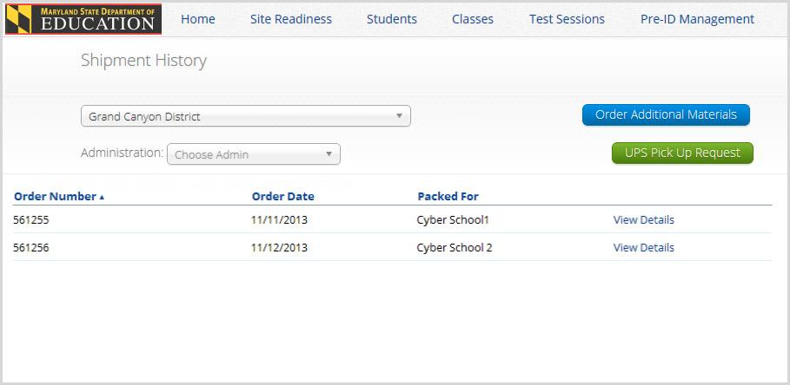
Materials Management

Slide 63
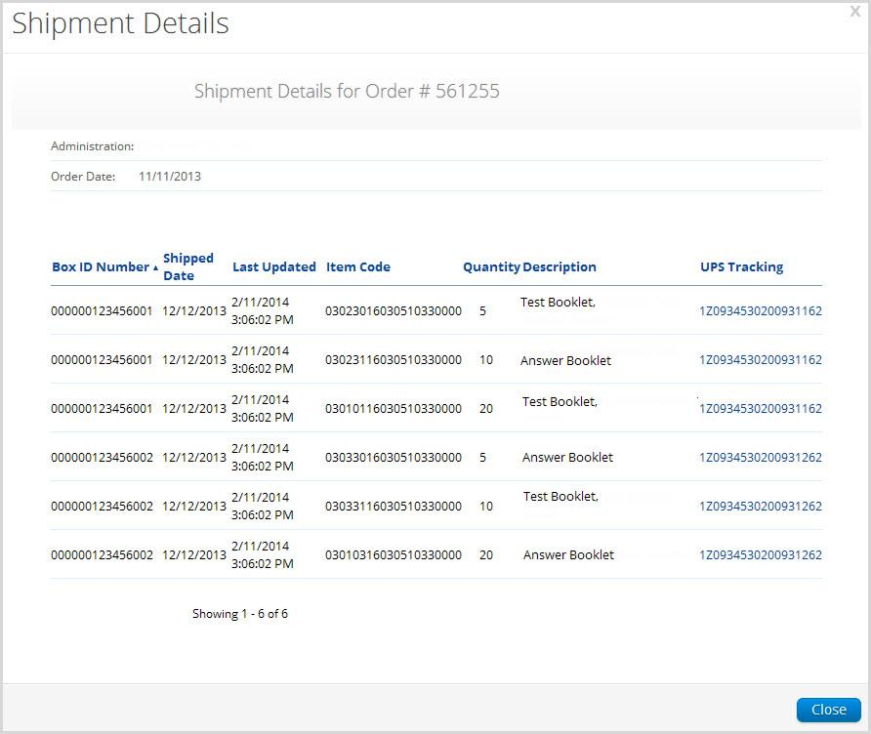
Materials Management

Slide 64
Materials Management
Additional Materials
To order materials you will need the school’s MP Ship Code. This code may be found on the Material Summary Form. (see example on next slide)
Additional test materials, may be ordered through Materials Management from December 11, 2020 – February 5, 2021
Manuals can be found on the Maryland Help & Support Site (https://maryland.onlinehelp.cognia.org) or ordered through Additional Materials

Slide 65
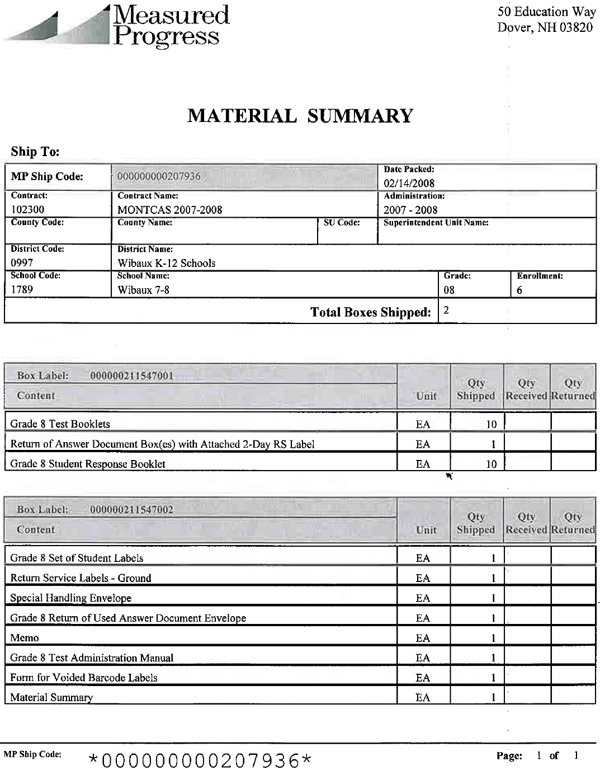
Materials Management
Additional Materials
MP Ship Code
NEW
Both MP Ship codes (Manuals or Test Material Shipment) will work.

Slide 66
Materials Management
Additional Materials

Slide 67
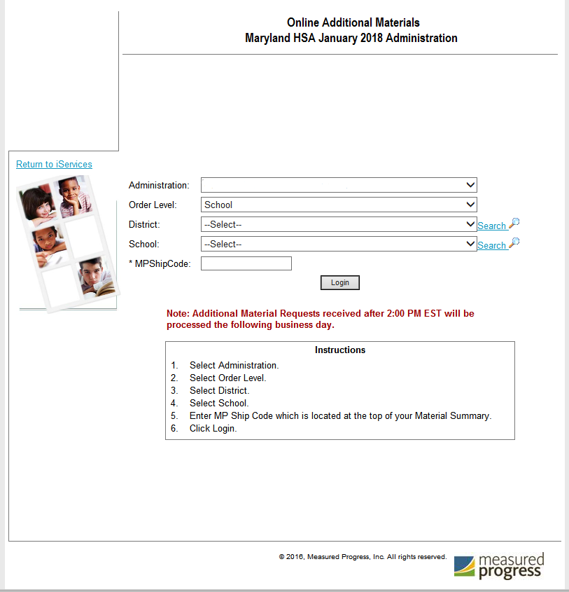
Materials Management
Additional Materials
Note: Additional Material Requests received after 12:30 PM EST will be processed the following business day

Slide 68
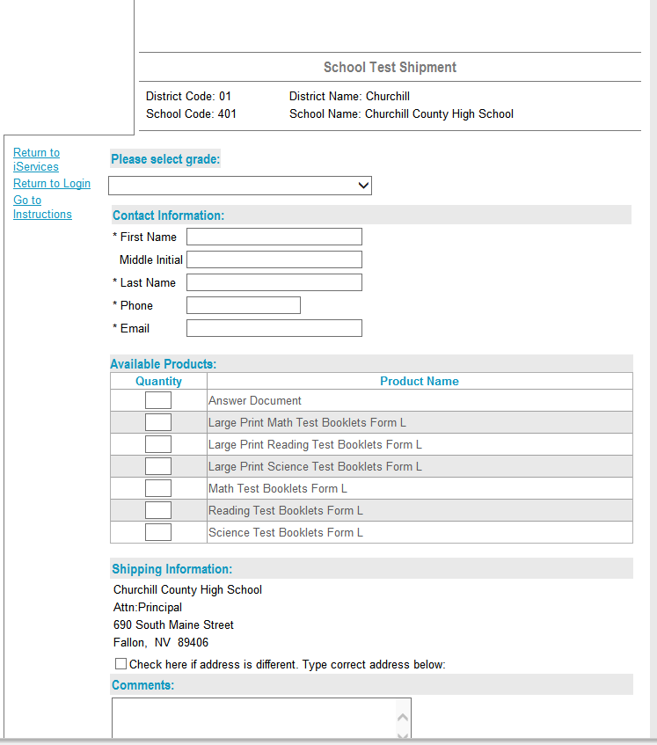
Materials Management
Additional Materials

Slide 69
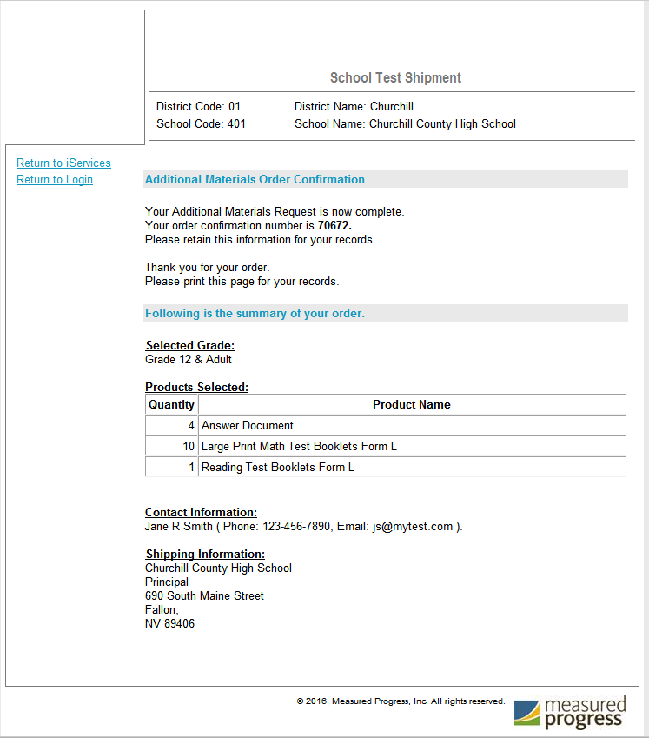
Materials Management
Additional Materials
Once the order is approved by MSDE and shipped, this number will appear on the Materials Management page.

Slide 70
Returning Materials
Special Handling Envelope
  Used Accommodated Materials
  Invalidated Answer Sheets
  LEA 55 Answer Sheets
Return of Used Answer Sheets Envelope (one for each content)

Slide 71
Returning Materials
Use the boxes that were sent to you
UPS return labels included in your shipment
White Tyvek envelopes (Used Answer Sheets Envelope, Special Handling Envelope)
Unused Answer Sheets (different each administration)
Used and Unused Test Books
Other test materials

Slide 72
Materials Management
Scheduling a UPS Pickup (January 18 – February 5)

Slide 73
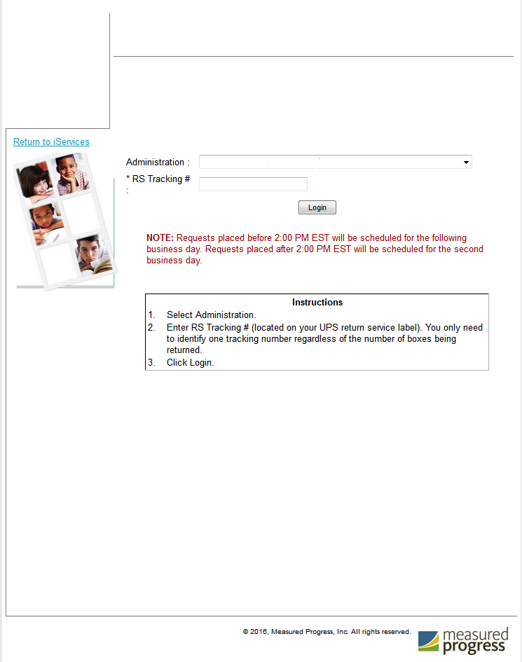
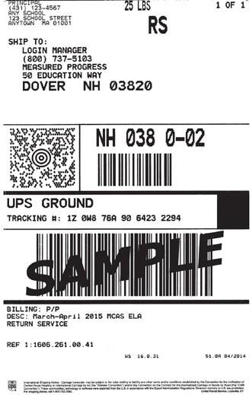
Materials Management
Scheduling a UPS Pickup (January 18 – February 5)
Online UPS Pickup Request
Maryland HSA January 2019

Slide 74
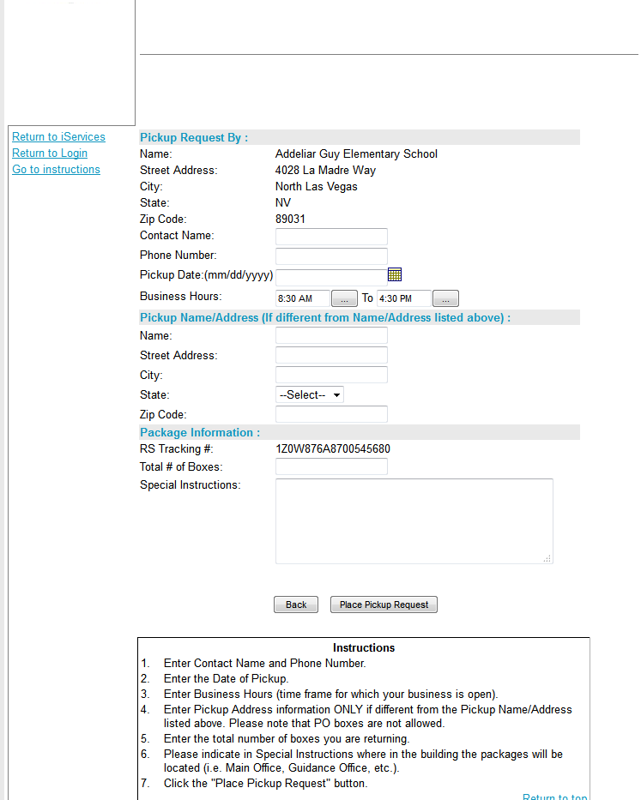
Materials Management
Scheduling a UPS Pickup (January 18 – February 5)
Online UPS Pickup Request
Maryland HSA January 2019
Your tracking number will automatically pull in your shipping information.
Fill out any other necessary information
Click on the grey Place Pickup Request button to schedule

Slide 75
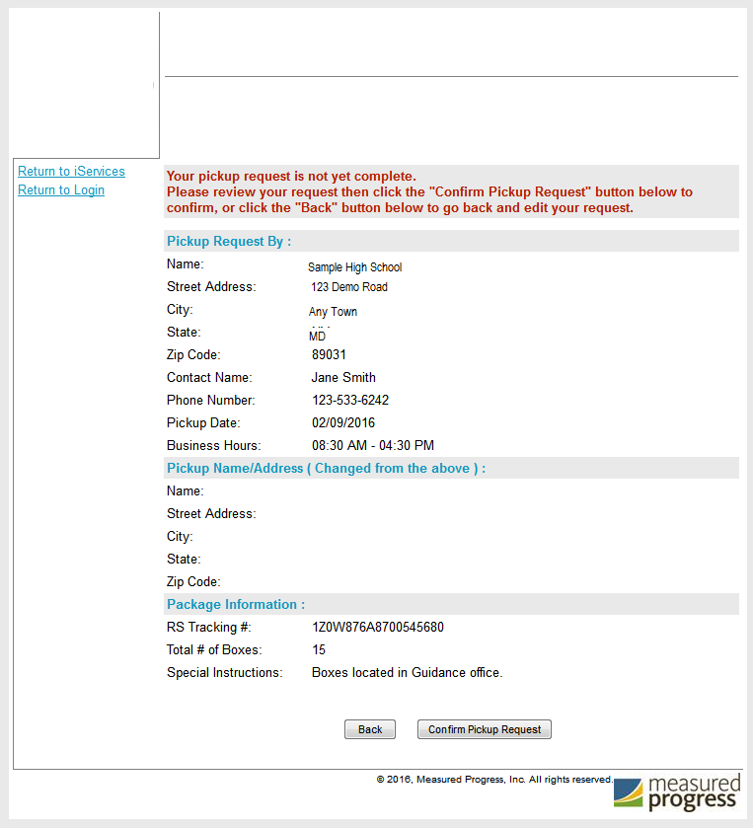
Materials Management
Scheduling a UPS Pickup (January 18 – February 5)
Online UPS Pickup Request
Maryland HSA January 2019
Make sure to review the pickup request one more time on the Confirmation Screen.
You will need to click the grey button Confirm Pickup Request to complete the schedule request

Slide 76
Support Materials
Maryland Help & Support Site
Modules
Weekly LAC/LEA 24 STC Communications
Quick Start Guides
Help Desk

Slide 77
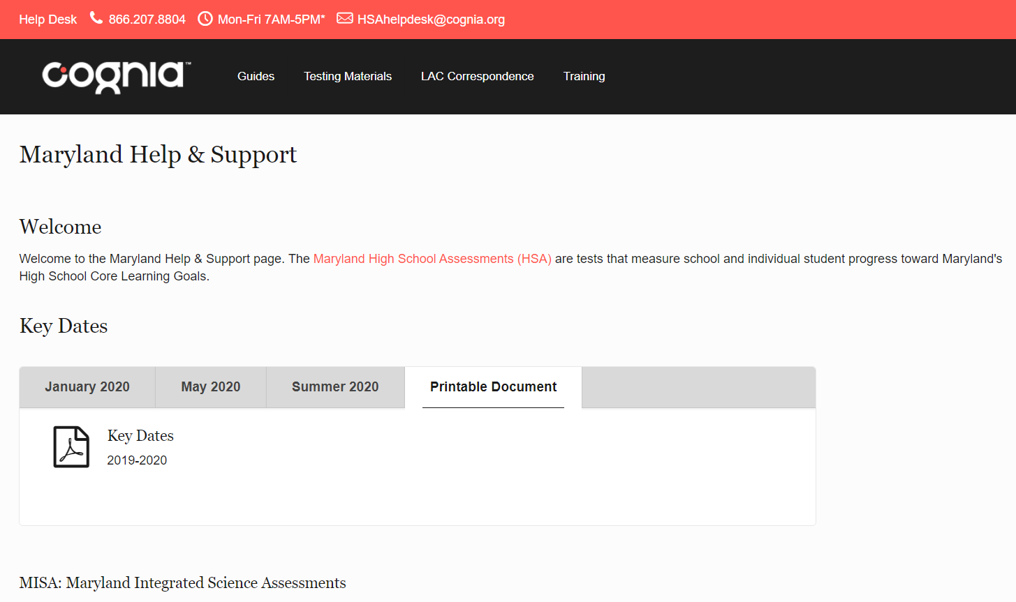
Maryland Help & Support Site
https://maryland.onlinehelp.cognia.org/

Slide 78
Maryland Analysis and Reporting System (MARS)

Slide 79
Maryland Analysis and Reporting System (MARS)
Overview of MARS
  How to Access
  Usernames & Passwords
  User Roles

Slide 80
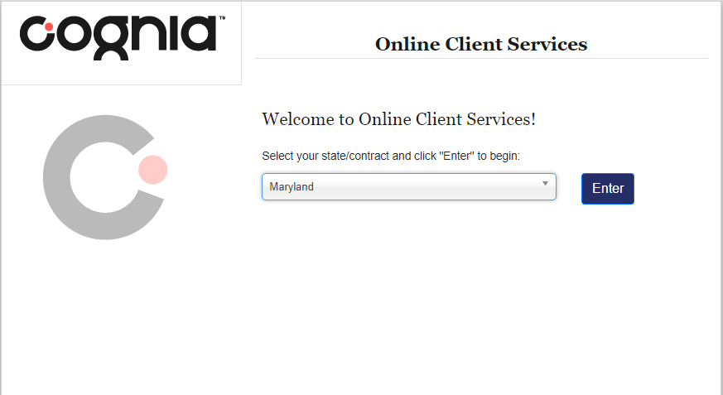
Maryland Analysis and Reporting System (MARS)
Accessing MARS
  Link within Help and Support Site
  http://iservices.cognia.org/
Select Maryland and click Enter

Slide 81
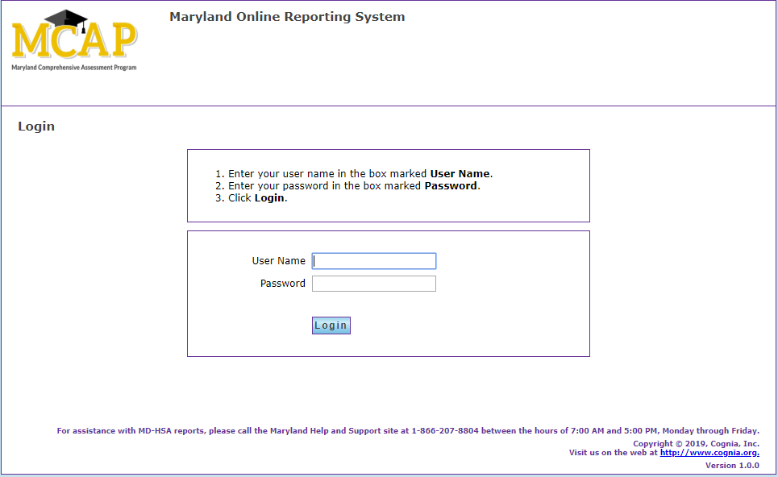
Maryland Analysis and Reporting System (MARS)
Usernames and Passwords have not changed
Contact helpdesk for assistance
Roles / Permissions:
State User / All Districts & Schools
LAC User / All Schools within Own LSS
School User / Own School

Slide 82
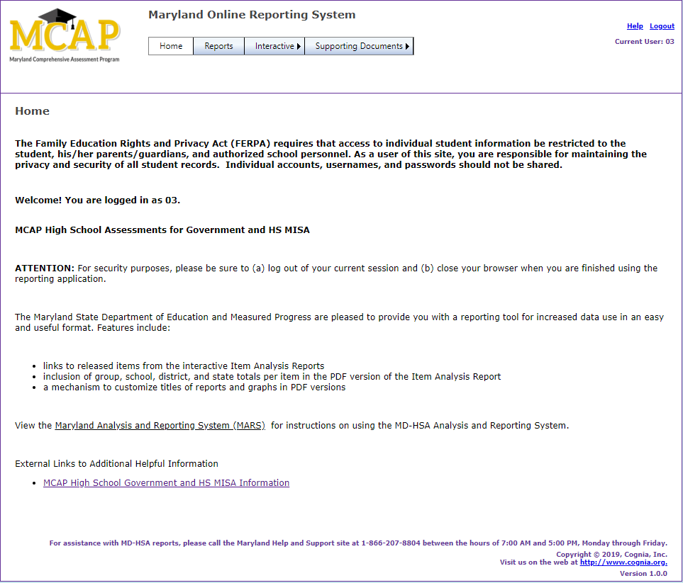
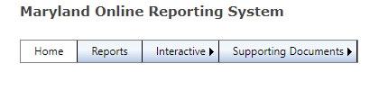
Maryland Analysis and Reporting System (MARS)
Reports (Static Report PDFs)
Individual Student Reports
Performance Level Summary Report
District Summary of Schools
School Roster Report
Score Labels

Slide 83
Maryland Analysis and Reporting System (MARS)
Interactive
Interactive reports can be customized and include:
Item Analysis Report
Performance Level Summary Chart

Slide 84



Have Additional Questions?
Cognia Technical Product Support
(866) 207-8804 or HSAhelpdesk@cognia.org
Help & Support Site maryland.onlinehelp.cognia.org

Slide 85


Thank you.
Cognia is a global nonprofit that has the knowledge to help schools improve outcomes for all learners.

