Slide 1
Maryland State
Department of Education
May 2018 HSA Administration
Overview for Local Accountability Coordinators
Brianna Creed
Program Manager for High School Assessments

Slide 2

Paper Accommodated Administration Schedule
Government HSA
Monday | Friday
05/14/2018 | 05/25/2018
HS MISA
Monday | Friday
05/14/2018 | 05/25/2018

Slide 3

Online Administration Schedule
Government HSA
Monday | Friday
05/07/2018 | 06/08/2018
HS MISA
Monday | Friday
05/07/2018 | 06/08/2018

Slide 4
Submission Dates (Files)
Task | Dates
Submit Initial Pre-ID Files (Online and Paper Testing)* | 02/20/18 – 03/09/18
Submit Additional Test Taker Accommodations on the HSA Portal | 03/12/18– 05/06/18
Second Pre-ID Files (Online and Paper Testing)* | 04/09/18 – 04/13/18
* All paper materials will be ordered off the initial enrollment Pre-ID files

Slide 5
Submission Dates (Additional Orders)
Additional Task | Dates
Submit Orders for any Additional Materials needed. Test Administrator Manuals Test Coordinator Manual Return Shipping Labels Test Booklets Answer Sheets | 04/25/18 - 05/31/18

Slide 6
Shipment Dates
Type of Shipment | Projected Delivery Dates | Additional Information
Manuals | April 9, 2018 | The paper copies of the Test Coordinator Manual (TCM) and the Test Administrators Manuals (TAM) will be shipped out to the LEAs and schools.
LAC NOTE: LACs do not receive HSA, Large Print, Braille, or Braille Kits in their overage shipment | April 30, 3018 | If you do not submit an Initial Pretest File, you will not receive a 5% overage shipment.
Initial School Shipments: Test materials and preprinted student ID labels | April 30, 2018 | Each content-area Administrator Kit will contain the preprinted ID labels for that content’s paper test-takers.
UPS Pickup Window for return to Measured Progress (Paper and secure testing materials) | 05/23/2018-06/12/2018 | All secure materials must be pick up/ returned by 06/12/18. *Tactile graphics must be pick up/ returned by 06/15/2018

Slide 7

Testing Reminders
1) Remind STCs and Test Administrators to:
  review and be familiar with IEPs before testing begins
  be sure each student is using the correct student authorization ticket
  Submit request to invalidate test to LAC (track in Appendix N) before the online testing window closes

Slide 8
Additional Reminders
  Be sure each paper test-taker is using his/her correct answer sheet with preprinted ID label.
  Be cognizant of students with similar names when distributing answer sheets. Be sure the student checks the sheet for other correct demographic information.
  Have students sign a Student Tracking Form to indicate they have taken the test and returned all test materials.
    See steps for exporting a student roster in HSA Portal

Slide 9
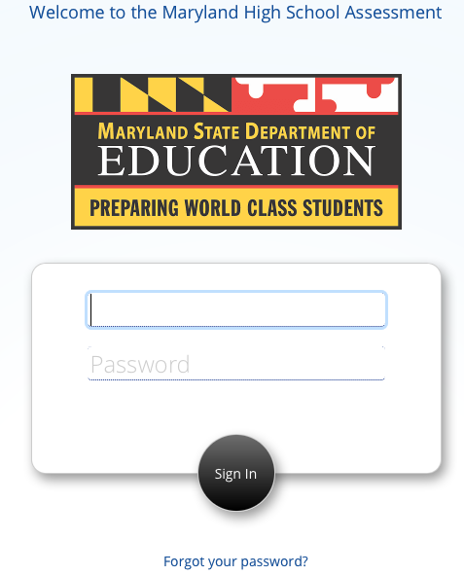
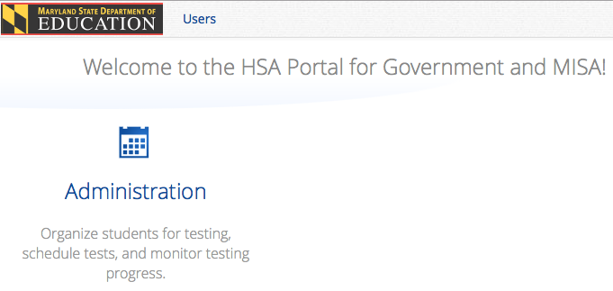
Export Student Roster - Step 1
Log in to hsaportal.measuredprogress.org with your HSA Portal username and password.
Click Administration

Slide 10
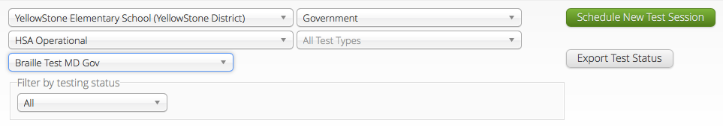
Export Student Roster - Step 2
Click Test Sessions in the top menu.
Select the correct school, content area (government or HS MISA), HSA Operational and the correct test name. Click Export Test Status.

Slide 11
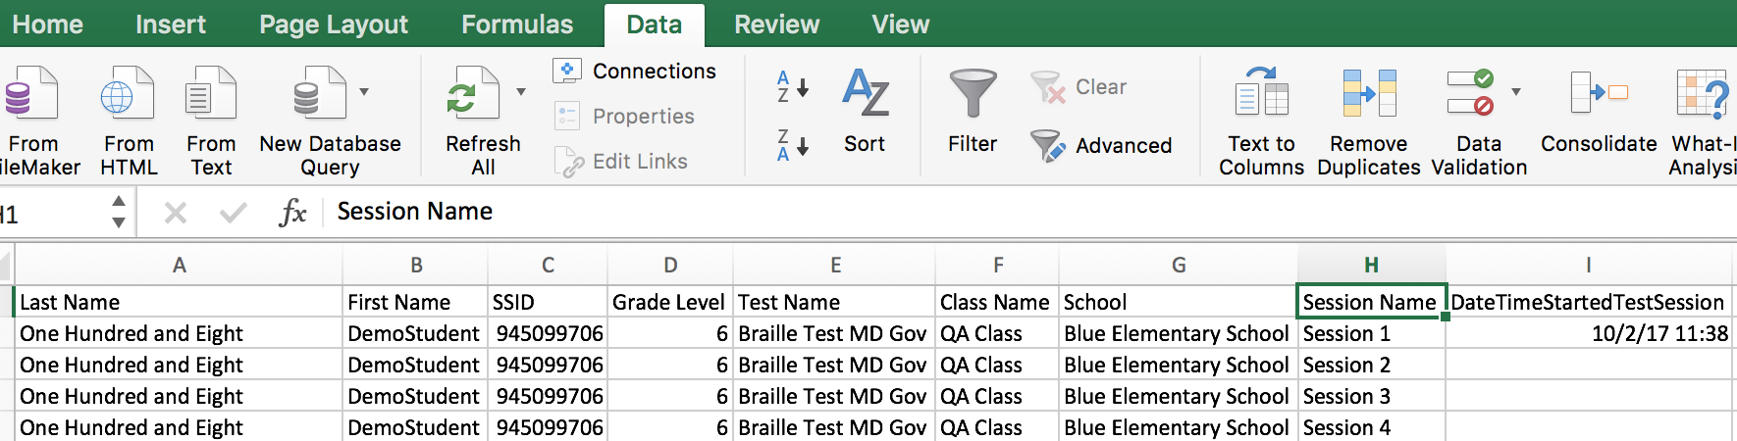
Export Student Roster - Step 3
A .csv file will download to your local machine. Open this file in Microsoft Excel.
Click a cell in Column H (called “Session Name”), select the Data Tab, and click Filter.

Slide 12
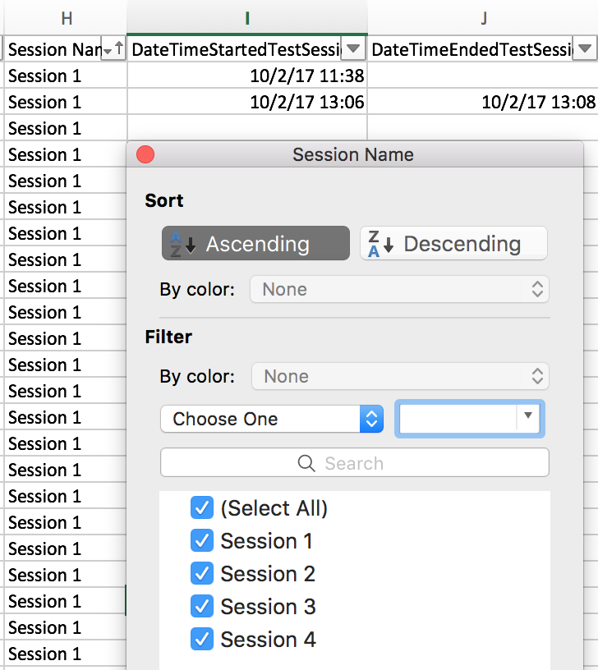
Export Student Roster - Step 4
You will see a down arrow appear in the heading of column H. Click this down arrow and select to sort in Ascending order.

Slide 13
Export Student Roster - Step 5
Delete all rows for Session 2, Session 3, and Session 4 as applicable.
Delete columns F-L (from “Class Name” through “StudentTestStatus”).

Slide 14
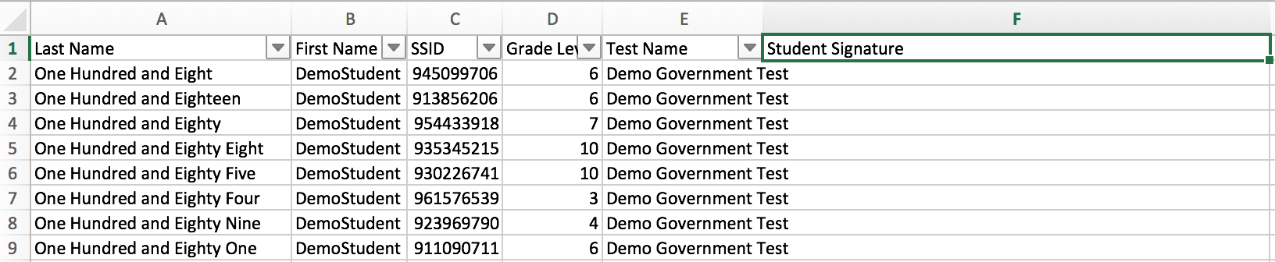
Export Student Roster - Step 6
In Column F, Row 1 type Student Signature
When you are ready to print, make sure all six columns (A-F) will fit on a single page. You may need to adjust the size of the margins, print in landscape rather than portrait, or make the font smaller.

Slide 15
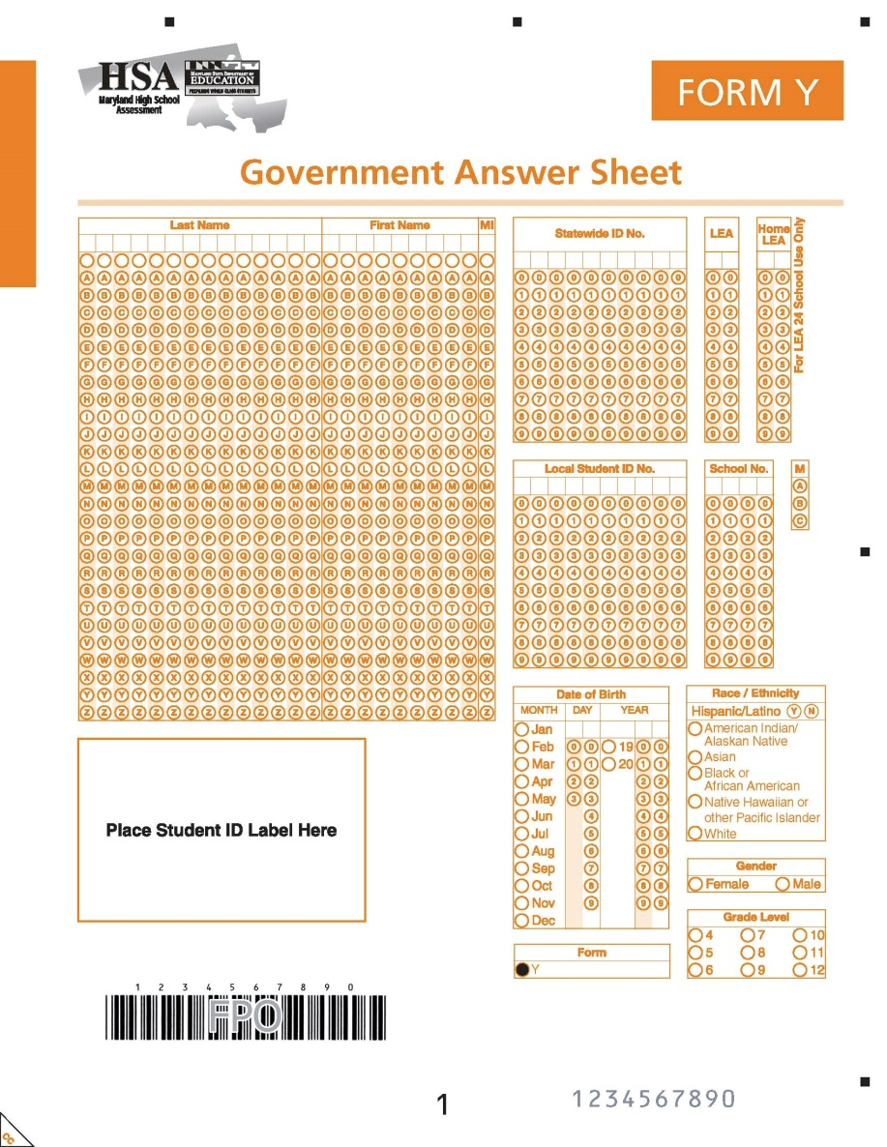
Additional Reminders
  Handwrite and bubble in student information on an Answer Sheet, when there is no student ID label
  Record and archive the student’s name, birthdate, and lithocode numbers of used Answer Sheets.

Slide 16
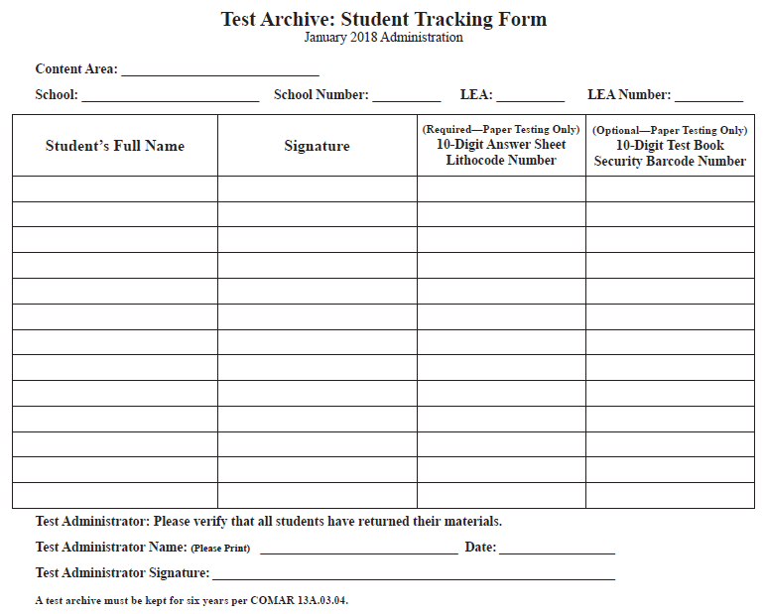
Additional Reminders
DO NOT FORGET TO RECORD EACH TEST-TAKER’S SIGNATURE. For paper test-takers also record their birthdate and answer sheet lithocode number.
For student using Large Print DO NOT FORGET TO RECORD THE LITHOCODE NUMBER OF THE REGULAR-SIZE ANSWER SHEET IN WHICH THE RESPONSES WERE TRANSCRIBED
For online testing, you can use the Student Roster to record student signatures.
For paper testing, you can use a Student Tracking Form locally created to record student signatures (Appendix I).
Schools may also use locally created rosters as long as all essential elements are included.
The signed rosters must be kept in the testing archives for six years.

Slide 17
Transcribing Reminders
Original Student Responses (Please refer to the Maryland Assessment, Accessibility, & Accommodations Policy Manual for specific information about both accommodations listed below.)
  Be sure student name is on all original student response materials, which include:
    used Large Print Answer Sheets
    standard-size or large print Test Books that have student responses
    audio-taped, brailled, or word-processed student responses
    used regular-size Answer Sheets that have been transcribed online
    For word-processed student responses, make sure that the internet
    and other functionalities have been turned off on the computer.
    New! At least two persons must be present during transcription of student responses. It is recommended that at least one of these persons be the STC.

Slide 18
Returning Shipment
Instructions for packaging materials can be found in Appendix B of the TCM.
Use your original boxes to return materials.
There will be return labels in your initial shipment to send back you materials.
There will be no header sheets this year.
Used Answer Sheets will be returned in white Tyvek envelopes labeled “Return of Used Sheets”. There will be one for each content.
Materials to return in the Special Handling Envelope:
  Invalidated Answer Sheets
  Homeschool Answer Sheets
  Accommodated test materials

Slide 19
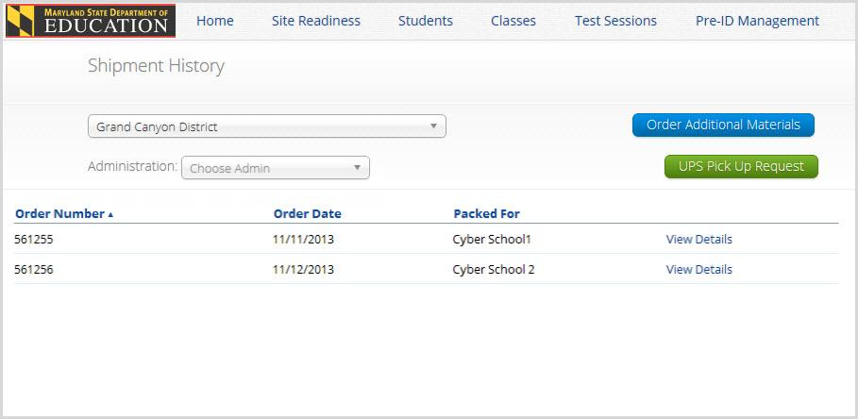
Pick-up Procedures
NEW THIS YEAR:
  All paper materials will be returned to Measured Progress (one location).
  Schools that have paper materials to return will need to schedule their UPS pickup. This can done through the Materials Management in the HSA Portal.
Note: All paper tester materials need to be picked up by June 12, 2018. All return shipments after that time will need to be sent back at the cost of the LEA. Directions for scheduling a UPS Pickup can be found in Appendix B of the Test Coordinator Manual. Only schools utilizing tactile graphics will have until June 15, 2018 for UPS Pickup.

Slide 20

Administration Results
LEAs will receive a Government score file:
  Government Score File (08/03/18)
  Government Score Labels (Digital File posted 08/10/18; printed labels in site by 08/17/18)
  Note: There will be no scores for HS MISA for 2018 since it is a field test year.

Slide 21
Site Readiness Test
Site Readiness should be conducted after installing the HSA Kiosk
Site Readiness testing is designed to simulate a test scenario and can identify potential technical problems before student testing
Instructions can be found in the HSA Portal Guide
The Site Readiness test should be completed by the staff responsible for assuring the HSA Kiosk is ready for testing.

Slide 22
PRACTICE!
Online Practice Test
The practice test can be accessed through the HSA kiosk or online at https://hsapracticetest.measuredprogress.org/student.
No ASL Videos
Government Practice Test
Username: practicegovernment
Password: maryland
HS MISA Practice Test
Username: practicehsmisa
Password: maryland
No ASL Videos
Government Practice Test
Username: practicegovernment
Password: maryland
HS MISA Practice Test
Username: practicehsmisa
Password: maryland

Slide 23
Contact Information
Brianna Creed
Program Manager for High School Assessments
Phone: 410-767-5171
Email: brianna.creed@maryland.gov

